Slide 1
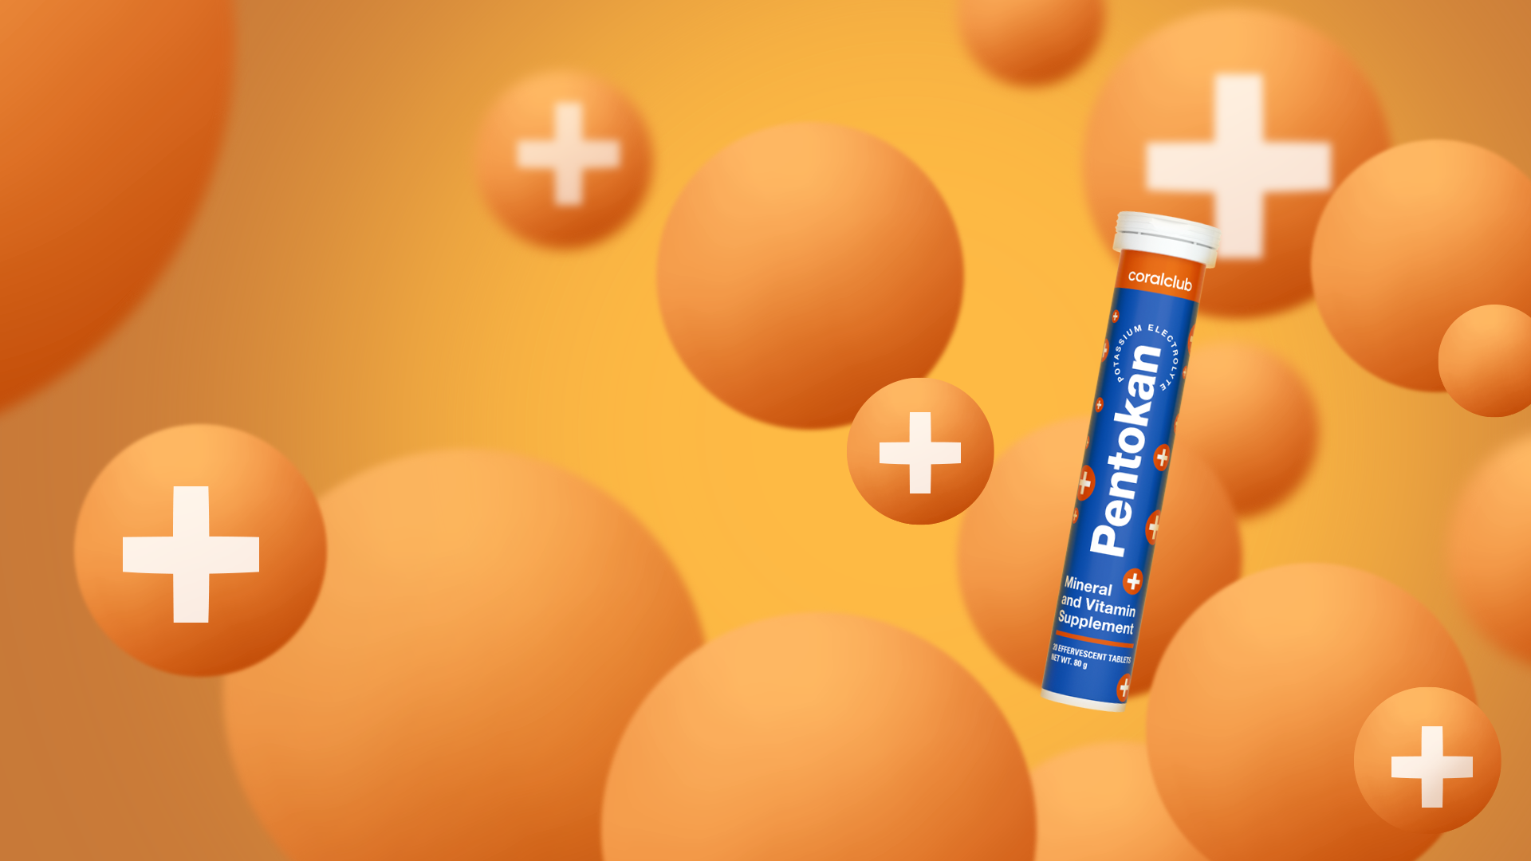

Pentokan
Power for Cellular Health*
*These statements have not been evaluated by the Food and Drug Administration. This product is not intended to diagnose, treat, cure, or prevent any disease.

Slide 2





Stress is an integral part
of modern life
It can result from any strong emotions; negative or positive.
Notes:
Stress... This condition has become an integral part of our lives. It accompanies us everywhere: at home, at work, in transport. But the concept of "stress" does not imply only negative emotions. On the contrary, bright, positive emotions that cause an emotional surge can also lead to this stressed state. Stress depletes our cells, tissues, accelerates aging, and, conversely, contributes to depression.

Slide 3






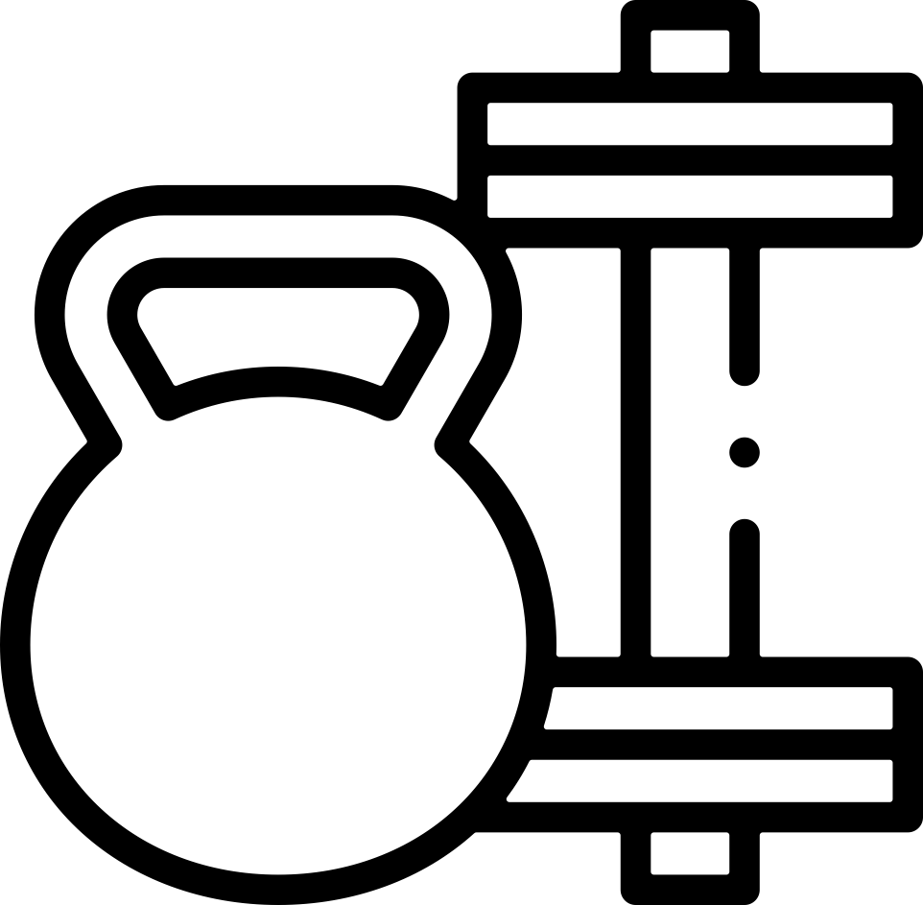

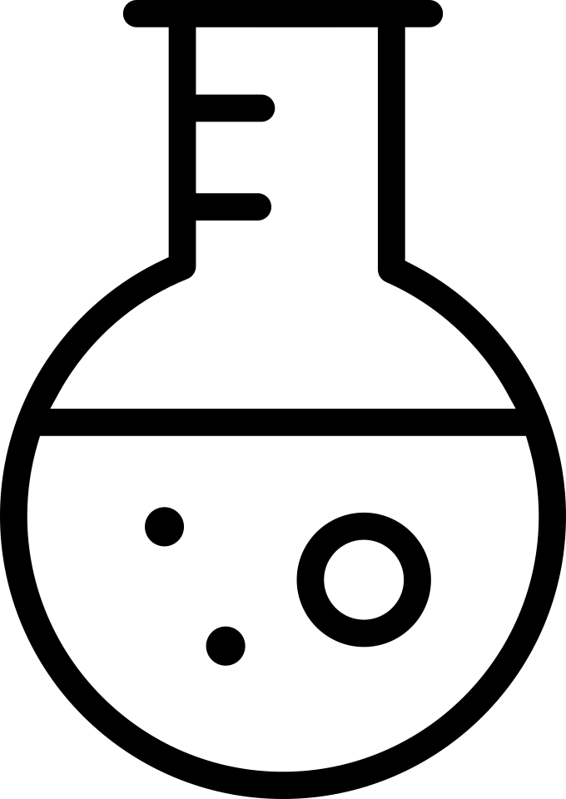

Other stress factors:
Notes:
The cause of stress is not only emotional experiences, but also:
Unfavorable ecological situation
Bacterial and viral infections
Natural aging of the body
Psycho-emotional stress, nervous tension
Excessive ultraviolet radiation, including being in the sun or in a solarium
Toxic components included in some cosmetics and household chemicals
Overeating, abuse of fast food, fried, canned food
Bad habits: smoking, alcohol abuse
Taking certain medications
Increased physical activity or, conversely, its absence
Lack of oxygen
Exposure to radiation, including from computers and phones

Slide 4
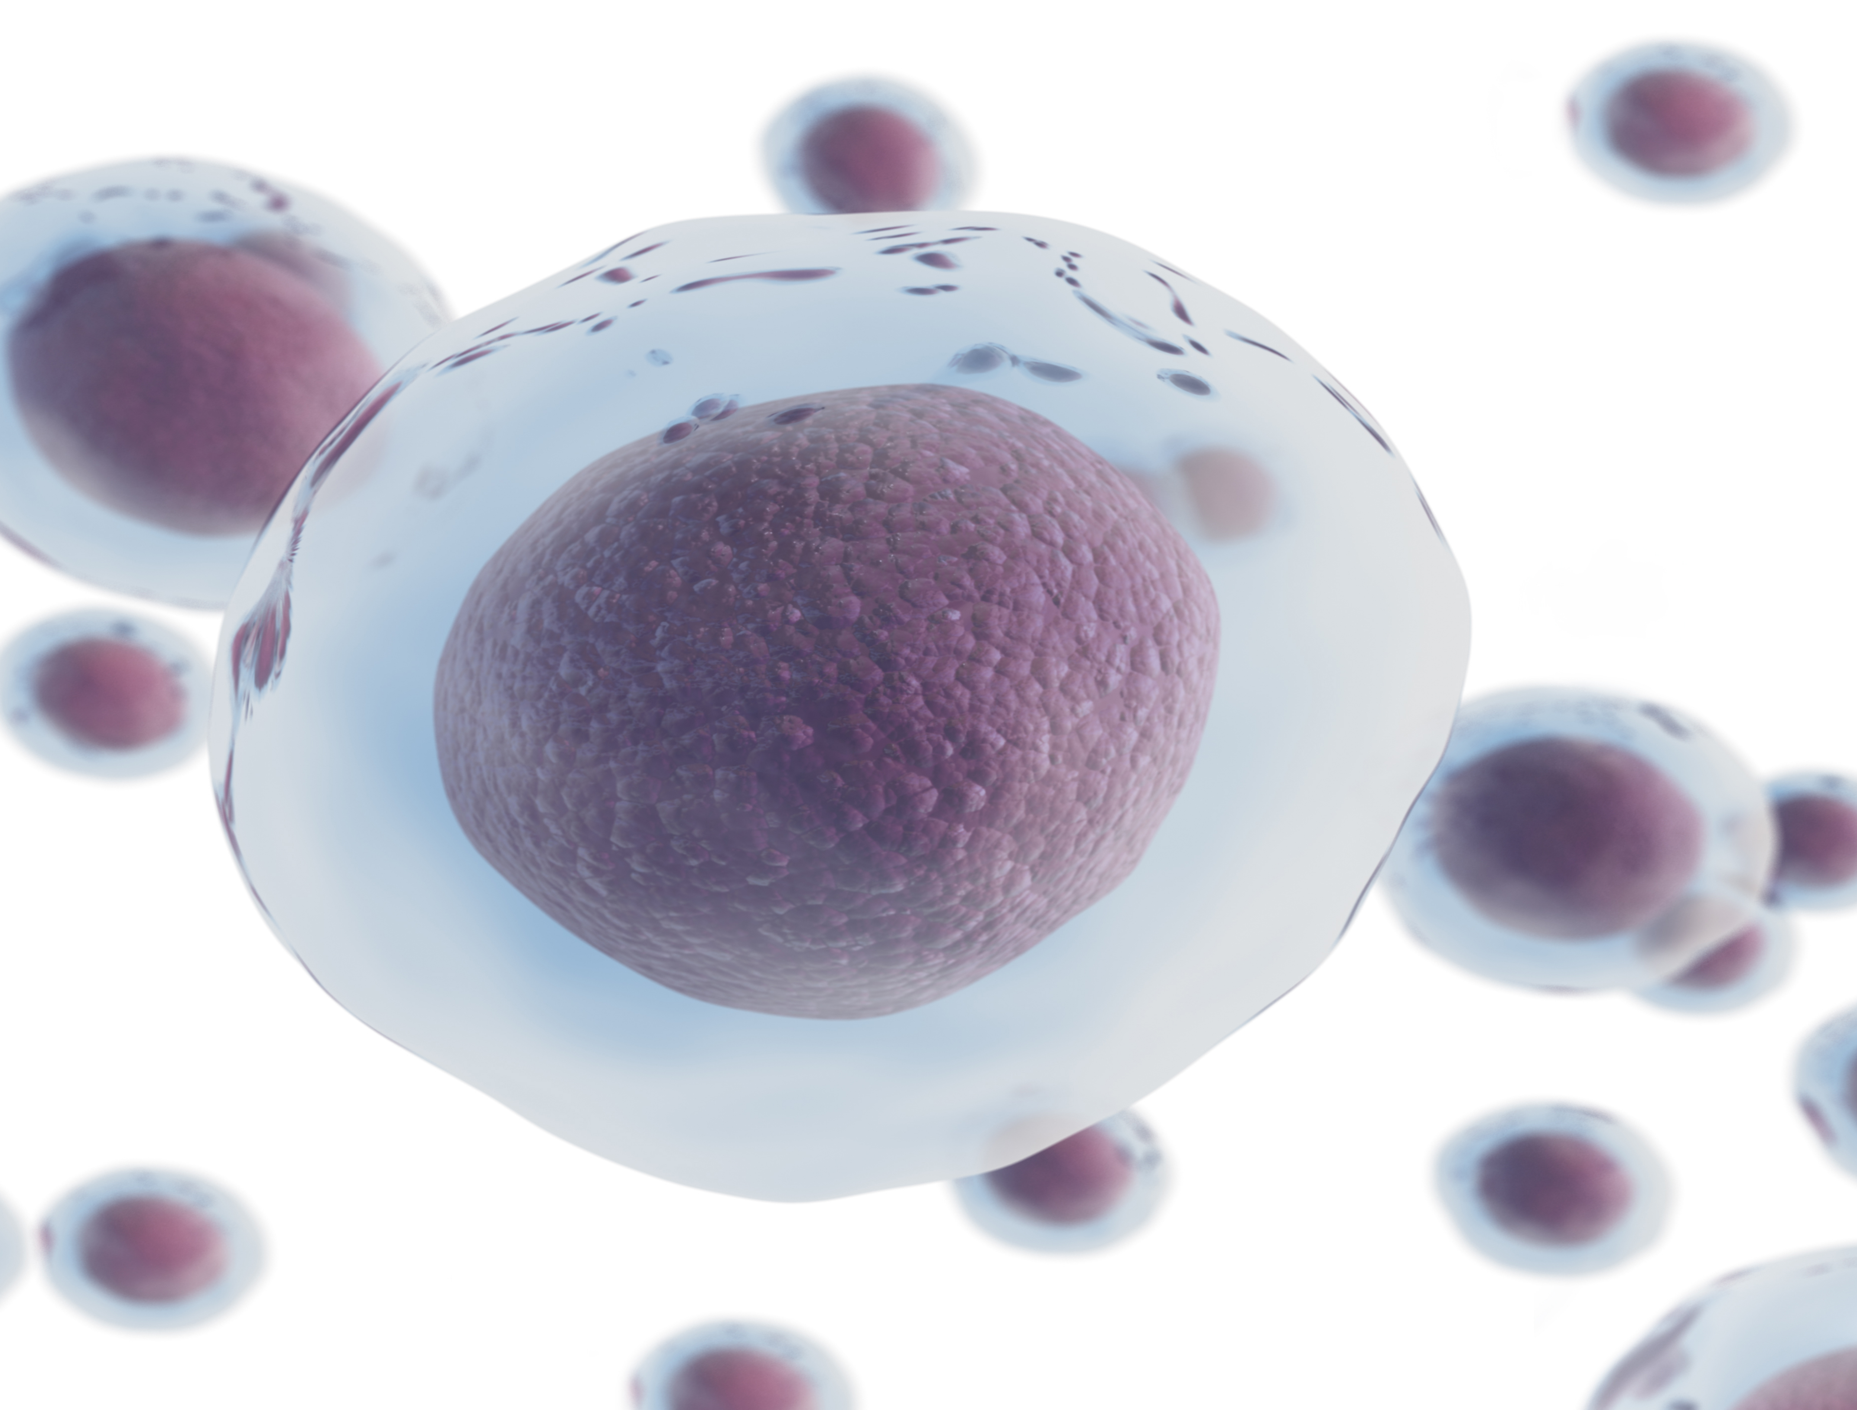
The result —
Strain on
the body’s cells
Stress strains the body’s cells, contributing to oxidative stress
Notes:
If an organism can quickly adapt or adjust to external or internal influences causing stress, then they are even beneficial. But if the body's protective and adaptive reserves are exhausted, this is a direct path to illness.
The same thing happens inside our body, and in every cell, it manifests as oxidative stress.
Oxidative (or oxidative) stress is cell damage by free radicals, as a result of which the body wears out and ages faster.
Failures in the work of various organs and systems occur, and diseases develop.

Slide 5
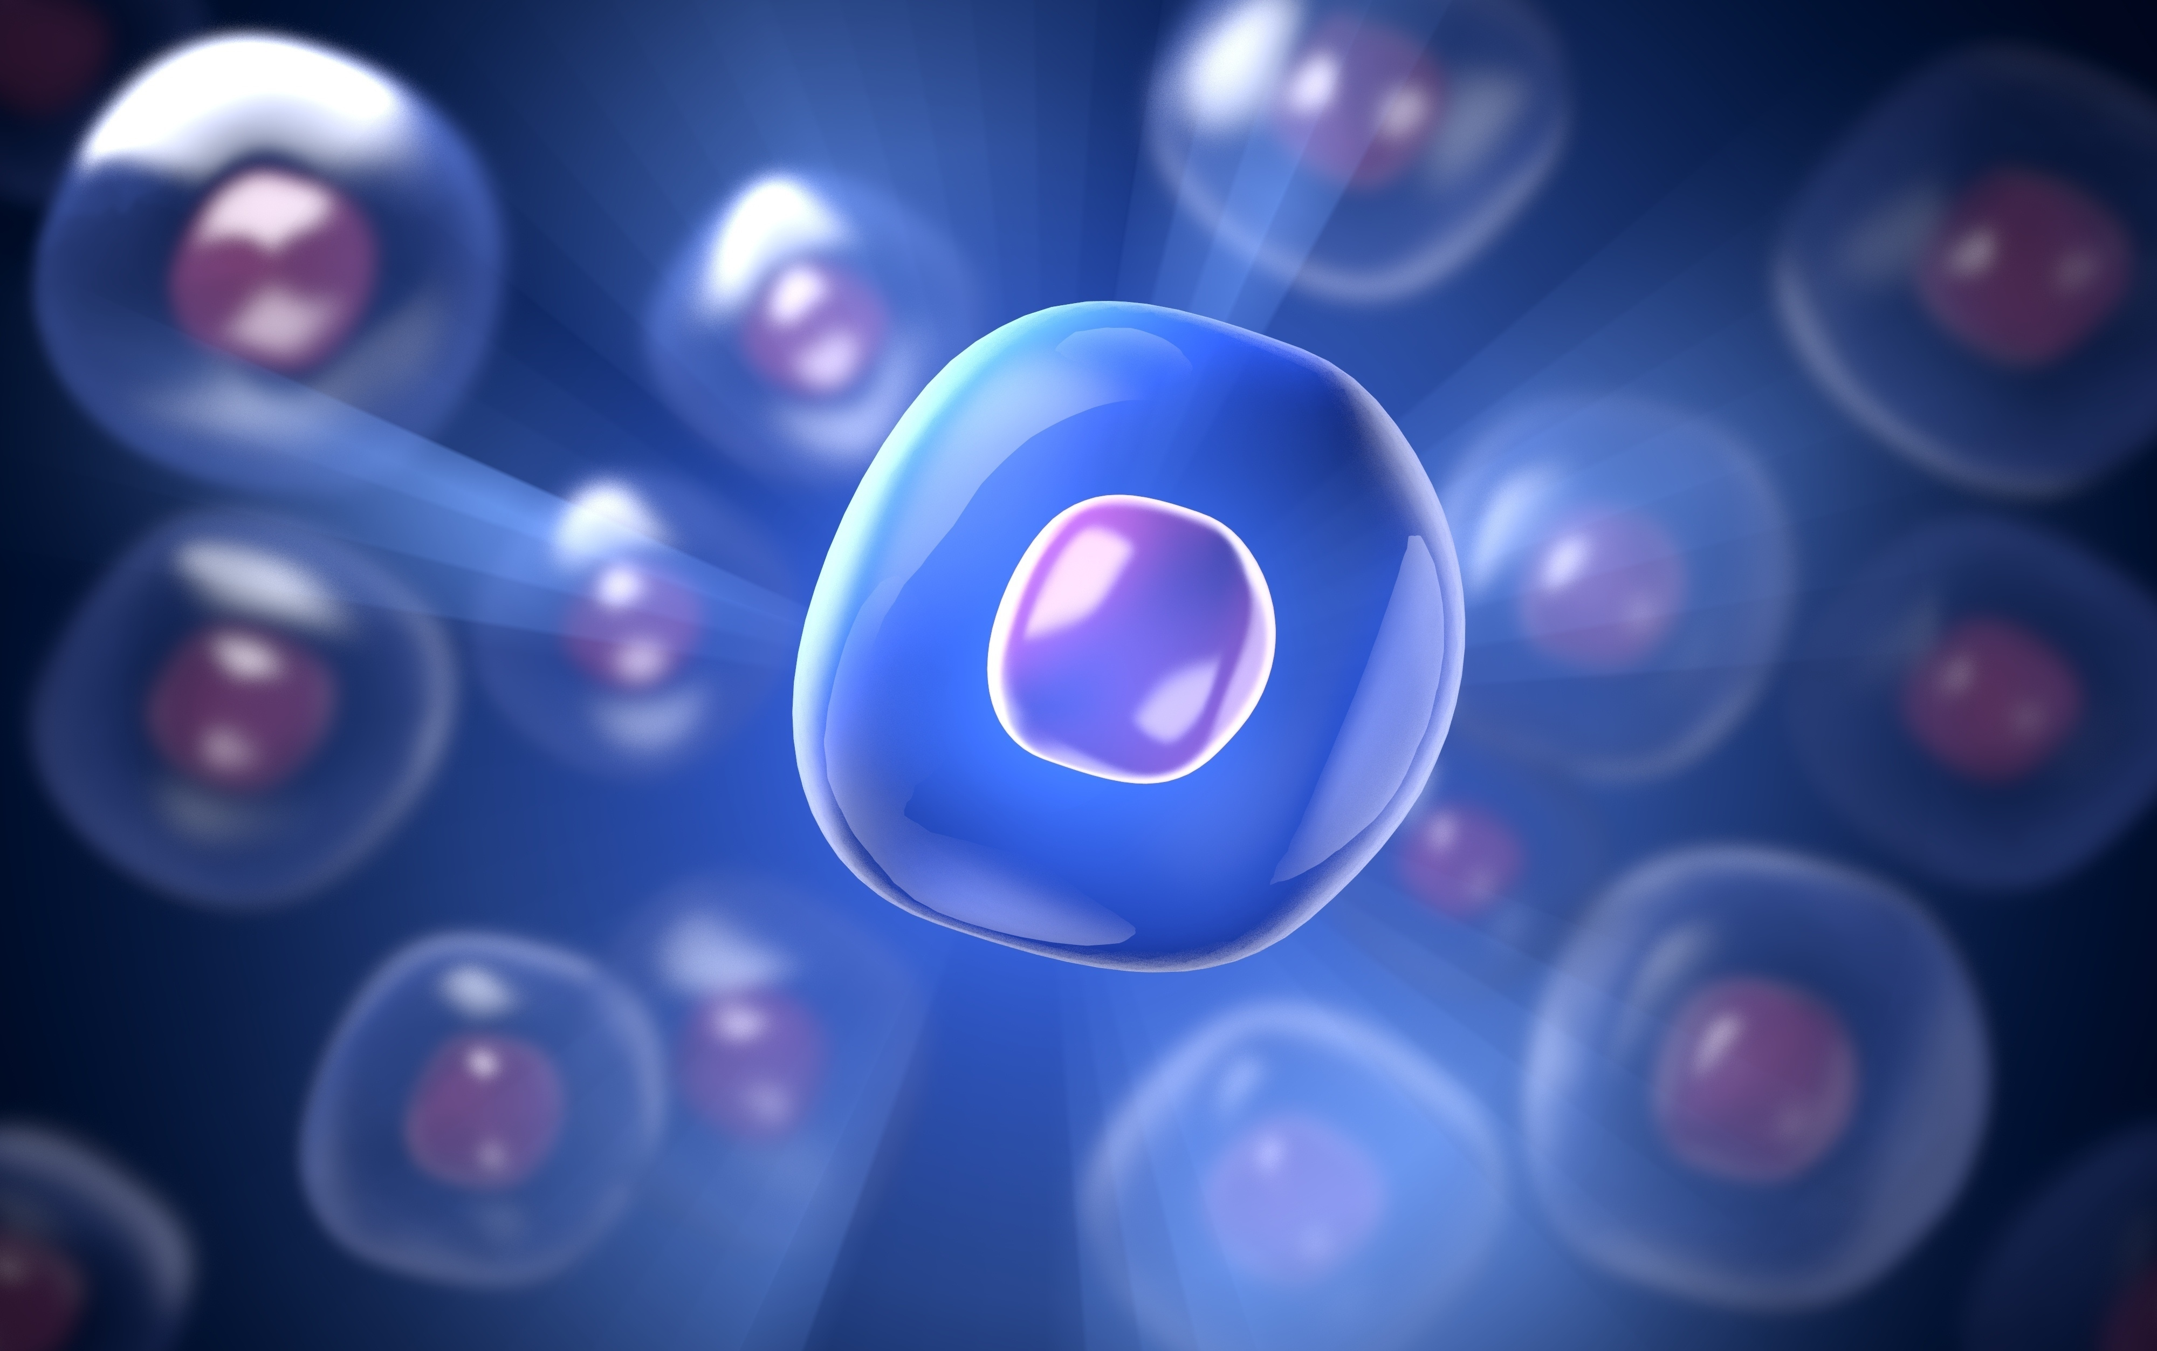
It all comes down
to your cells
Notes:
The human body contains 100 trillion cells, and in each of them, billions of chemical reactions occur daily, ensuring the smooth functioning of organs and systems. All these processes in their entirety are called metabolism, or metabolism. Metabolism constantly changes, adapts, and responds to changes occurring within cells.
To minimize the negative effects of free radicals, it is important to support normal cellular metabolism.
Taking care of your health means starting at the cellular level.

Slide 6
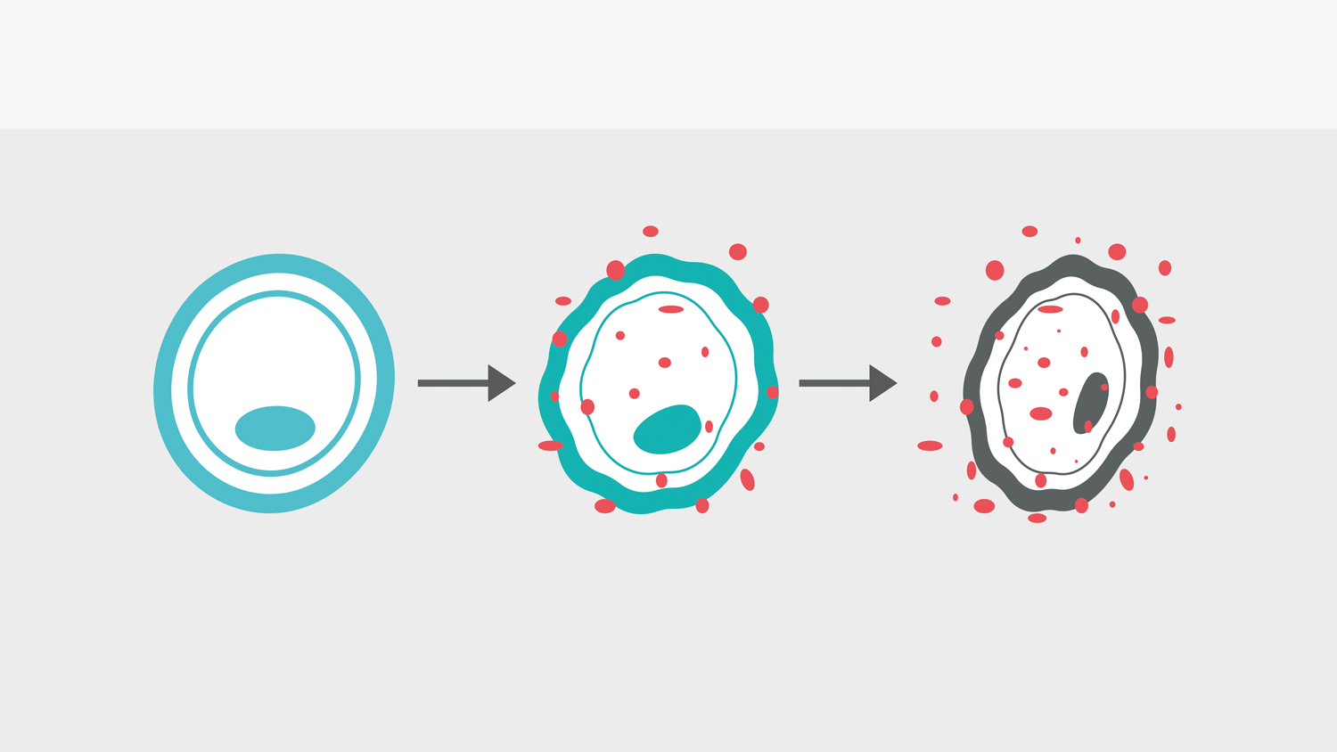

Oxidative stress
“Free radicals” attack
Damaged cell
Healthy Cell
Notes:
To improve cellular metabolism, either neutralize free radicals with the help of an antioxidant system, or change unfavorable lifestyles.
At a high level, free radicals resemble hungry wolves – they attack healthy cells. An excessive amount of free radicals, if not neutralized in time, can damage healthy cells and tissues and cause pathological processes.
This is how oxidative stress works.

Slide 7
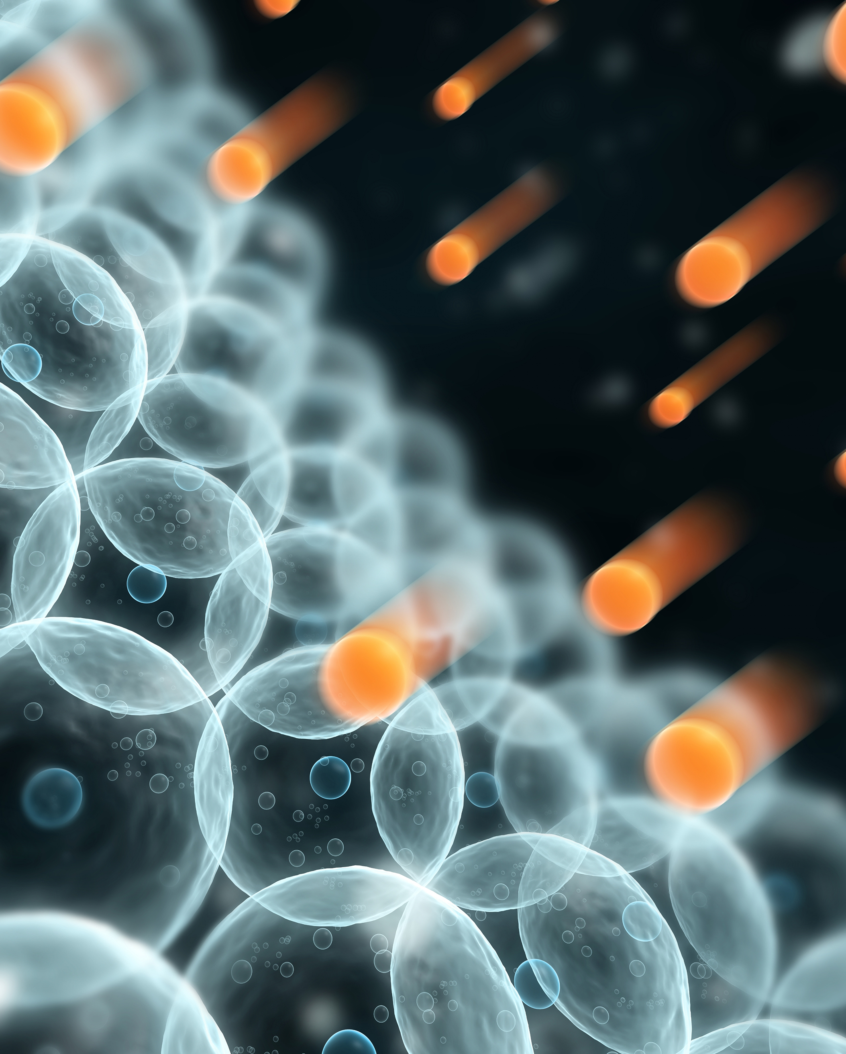
Free radicals:
Unstable Molecules
Nearly 1 trillion free radicals are formed in one cell each day.
10
12
Notes:
What is a "free radical" and how does it work?
A free radical is an oxygen molecule with an unpaired electron.
Striving to become stable, a free radical literally tears off a missing electron from any source, thereby damaging cells and causing internal destruction — a truly vicious circle that is responsible for the development of most diseases — from cataracts and bronchial asthma to cancer.

Slide 8
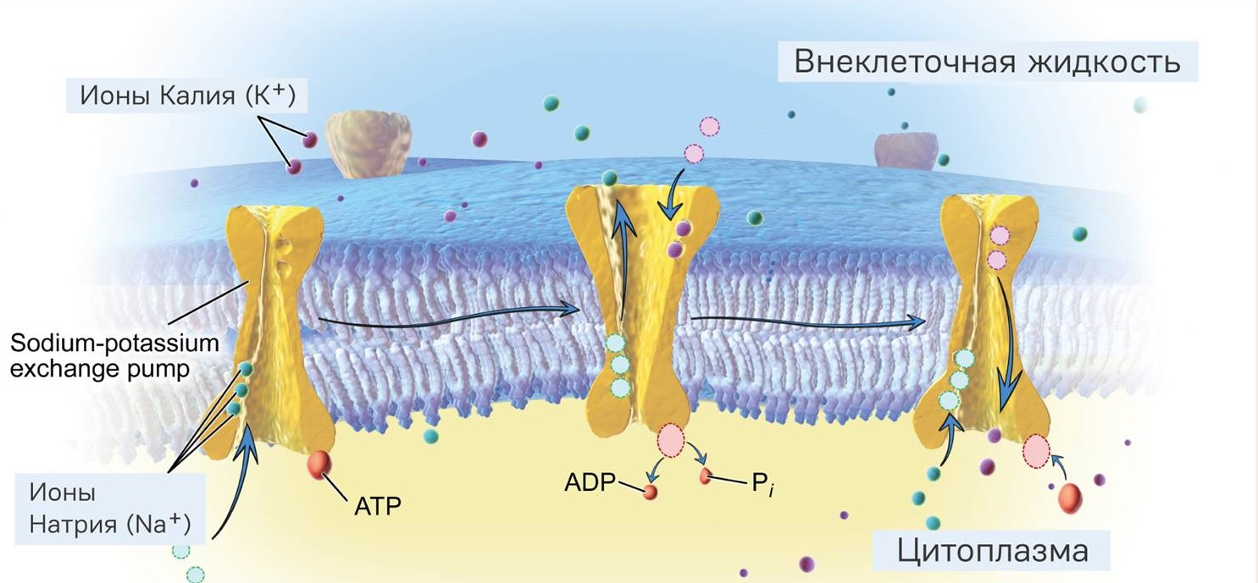
Extracellular fluid
Potassium Ions (K+)
Sodium Ions (Na+)
Cytoplasm
Sodium-Potassium Pump
Notes:
To achieve optimal cellular metabolism, a balanced intake of vitamins, minerals, amino acids, enzymes, and other biologically active substances is essential. These substances act as catalysts and regulators of all chemical processes in the cell, helping to convert food into energy and building blocks for new cells.
Potassium and sodium play a particularly important role in this. These are the two most important intracellular cations that ensure the entry of nutrients into the cell, maintaining a certain acid-base balance, and participating in the removal of metabolic waste products.
Without these two substances, simply impossible to maintain normal heart rhythm, ensure healthy and water-salt balance, and other important metabolic processes.

Slide 9
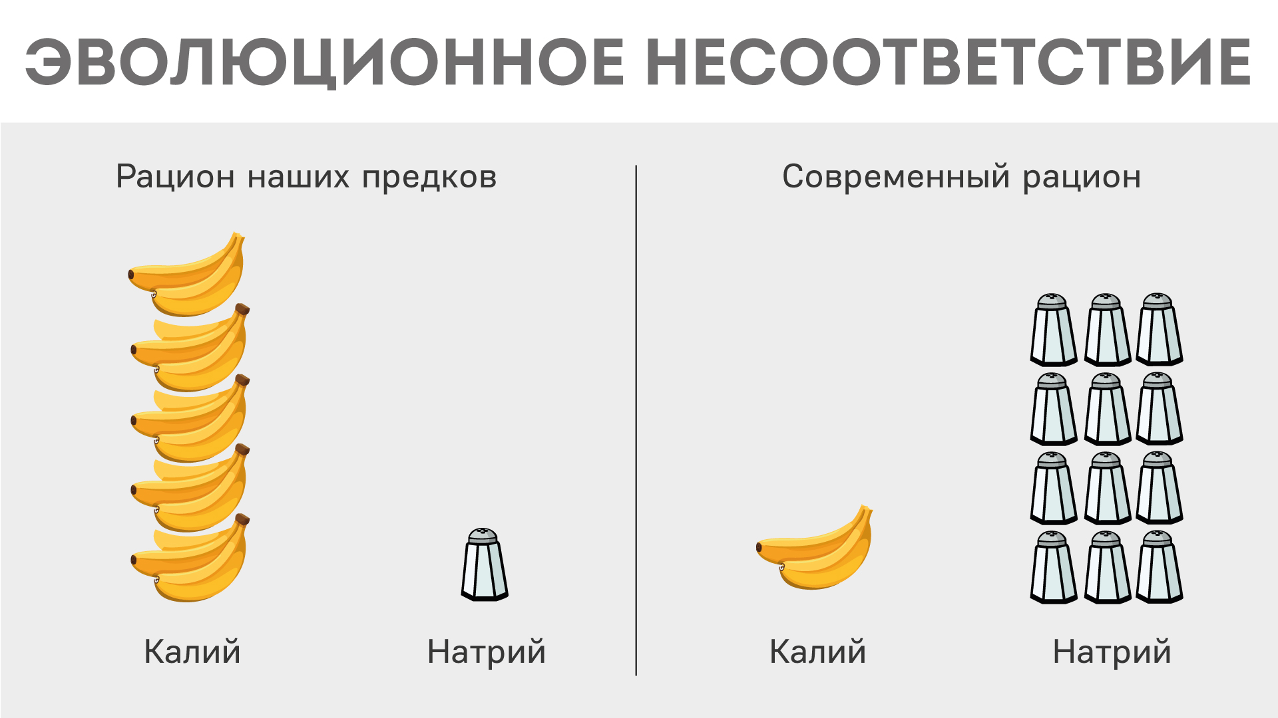
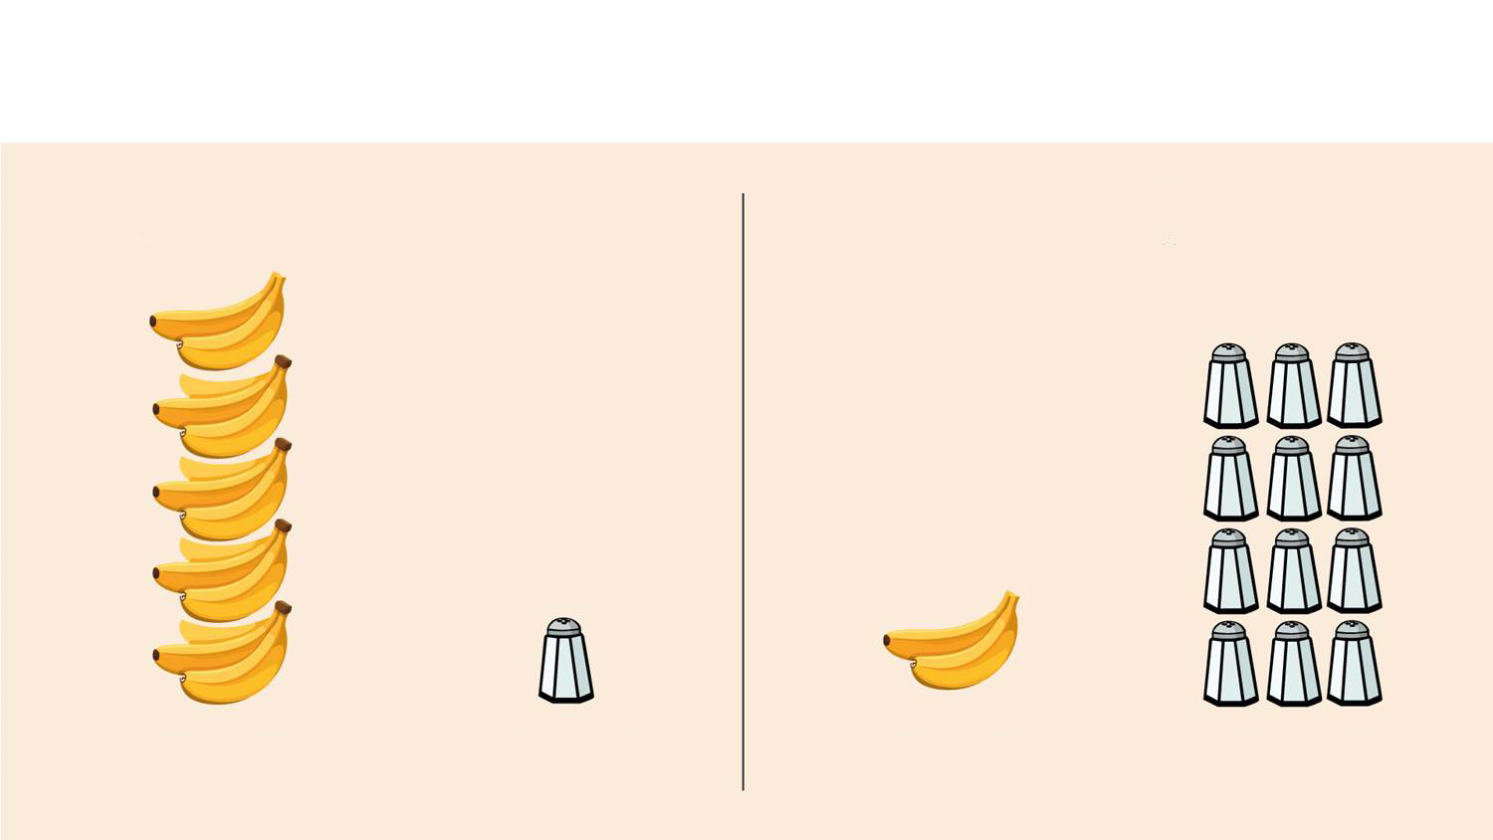
Evolutionary Mismatch: From Balance to Imbalance
Our Ancestors’ Diet
Modern Human Diet
Potassium
Sodium
Potassium
Sodium
Notes:
One of the main reasons for potassium deficiency in the modern human body is excessive sodium (salt) intake.
The fact is that, from an evolutionary point of view, salt used to be a rarity, but now it enters the body in excess. Sodium is absolutely necessary for neurological and muscular functioning; life is impossible without it. The same can be said for potassium. Of these two vital active substances, only sodium is always found in large quantities.
The body, by nature, is aimed at retaining sodium and excreting potassium. It has powerful mechanisms for sodium retention, but it lacks mechanisms for active potassium retention, which is so necessary for life.
As a result, we consume salt in a much larger quantity than necessary and consume very few potassium-rich plant foods (or, if we add salt to them, then with salt).
Ultimately, this leads to a sodium imbalance, which in turn leads to various health problems.
This is the case where evolution works against us, not having managed to adapt to the changes.

Slide 10
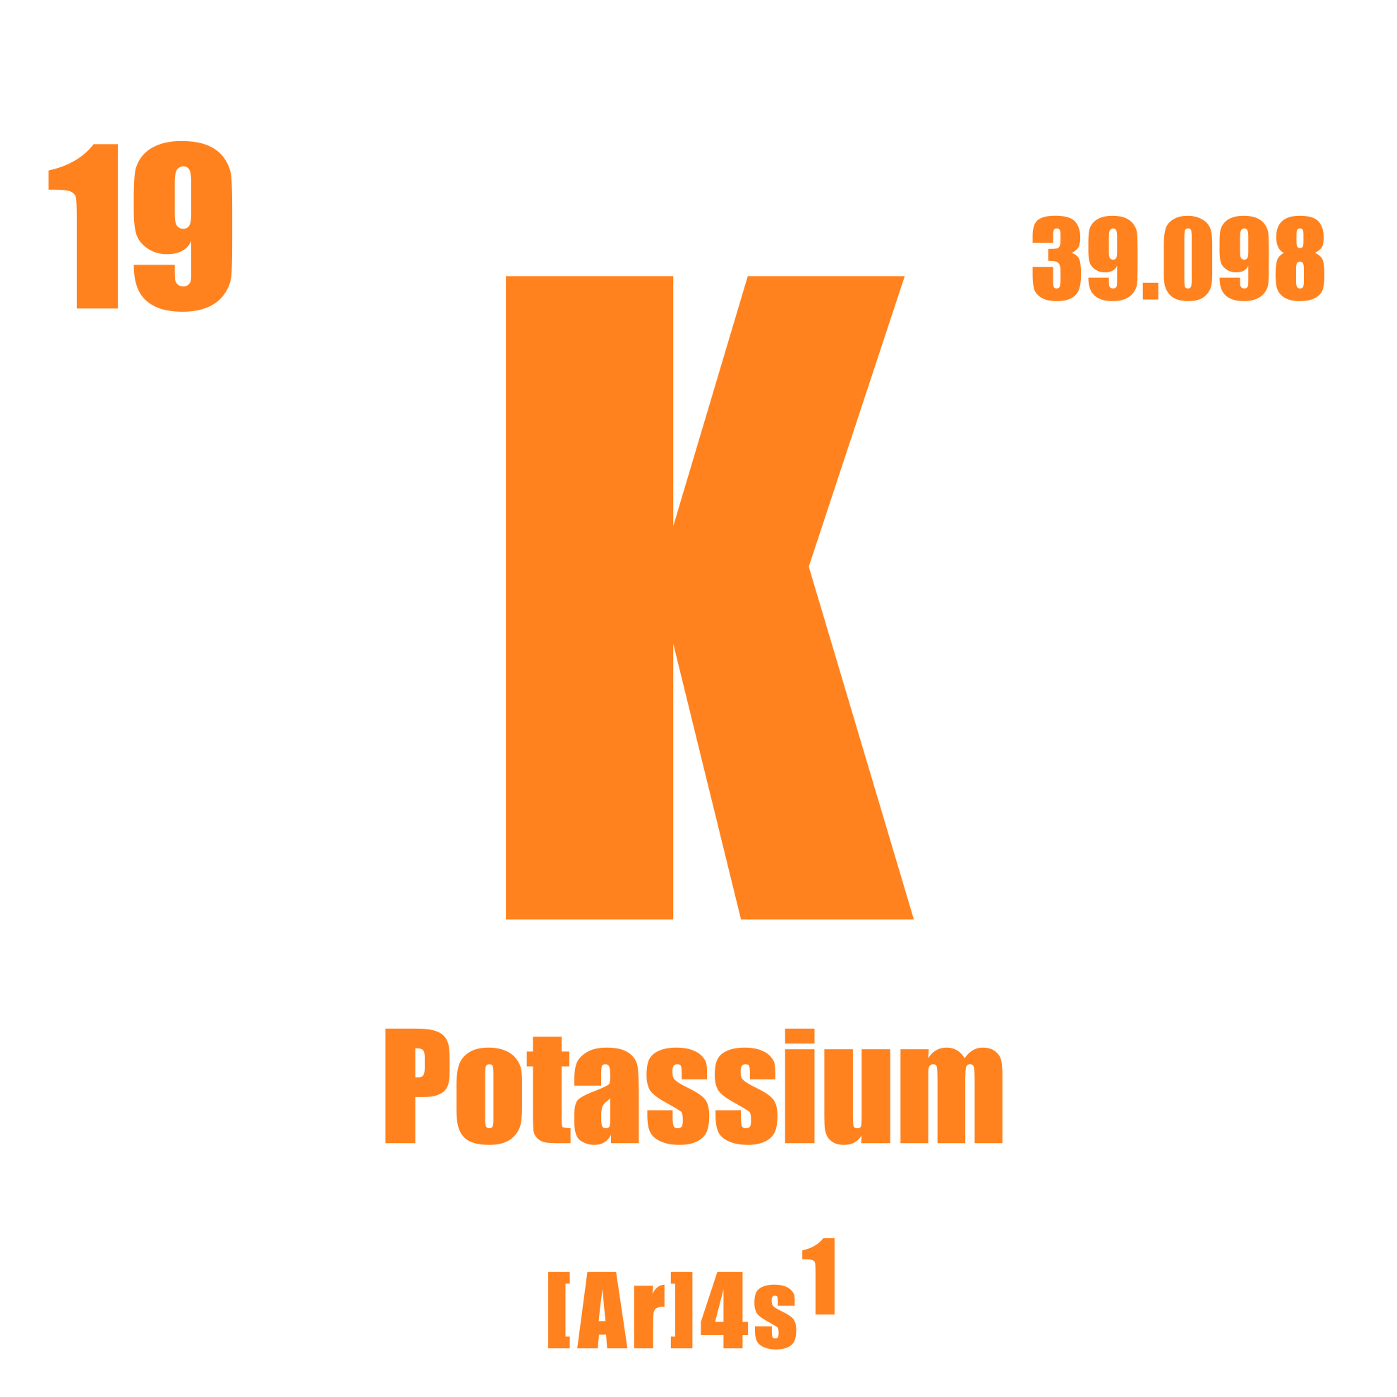
Functions of Potassium*
Supports acid-base balance
Ensures intercellular contacts
Ensures bioelectrical activity to cells
Maintains neuromuscular excitability
Participates in regulation of heart contractions
Maintains water-salt balance
Catalyst in carbohydrate and protein metabolism
Maintains normal blood pressure
Participates in ensuring the excretory function of the kidneys
*These statements have not been evaluated by the Food and Drug Administration. This product is not intended to diagnose, treat, cure, or prevent any disease.
Notes:
Potassium is one of the most important elements for the life support of the body's cells.
Why is potassium so important for the normal functioning of the body?
Potassium helps normalize the intracellular acid-base balance, which is very important for overall health.
Potassium is an electrolyte necessary for conducting nerve impulses. The normal functioning of the nervous system, including the brain, largely depends on it.
Potassium helps increase muscle endurance, which is especially important if you actively play sports or lead an active lifestyle.
Potassium is good for heart health and helps maintain a normal heart rhythm.
Potassium maintains the water-salt balance in the body; a disturbance of this balance threatens serious health problems.
Potassium activates energy metabolism, maintaining the body's high performance.
Potassium maintains normal blood pressure.
Potassium helps the kidneys perform their function normally.

Slide 11

Low Potassium levels may*:
Affect normal energy levels
Influence mood and focus
Contribute to occasional fatigue
Reduce muscle efficiency
Impact nerve responsiveness
Affect hydration and water balance
Affect electrolyte balance
*These statements have not been evaluated by the Food and Drug Administration. This product is not intended to diagnose, treat, cure, or prevent any disease.
Notes:
Potassium deficiency often manifests as a decline in strength, apathy, and emotional burnout.
In addition to intense physical activity and excess salt in the diet, it can be provoked by factors such as:
regular stress
intense physical activity
bad habits (alcohol, smoking)
poor environmental conditions
taking diuretics or laxatives
dehydration due to vomiting or diarrhea
increased sweating
frequent consumption of chocolate and coffee.

Slide 12
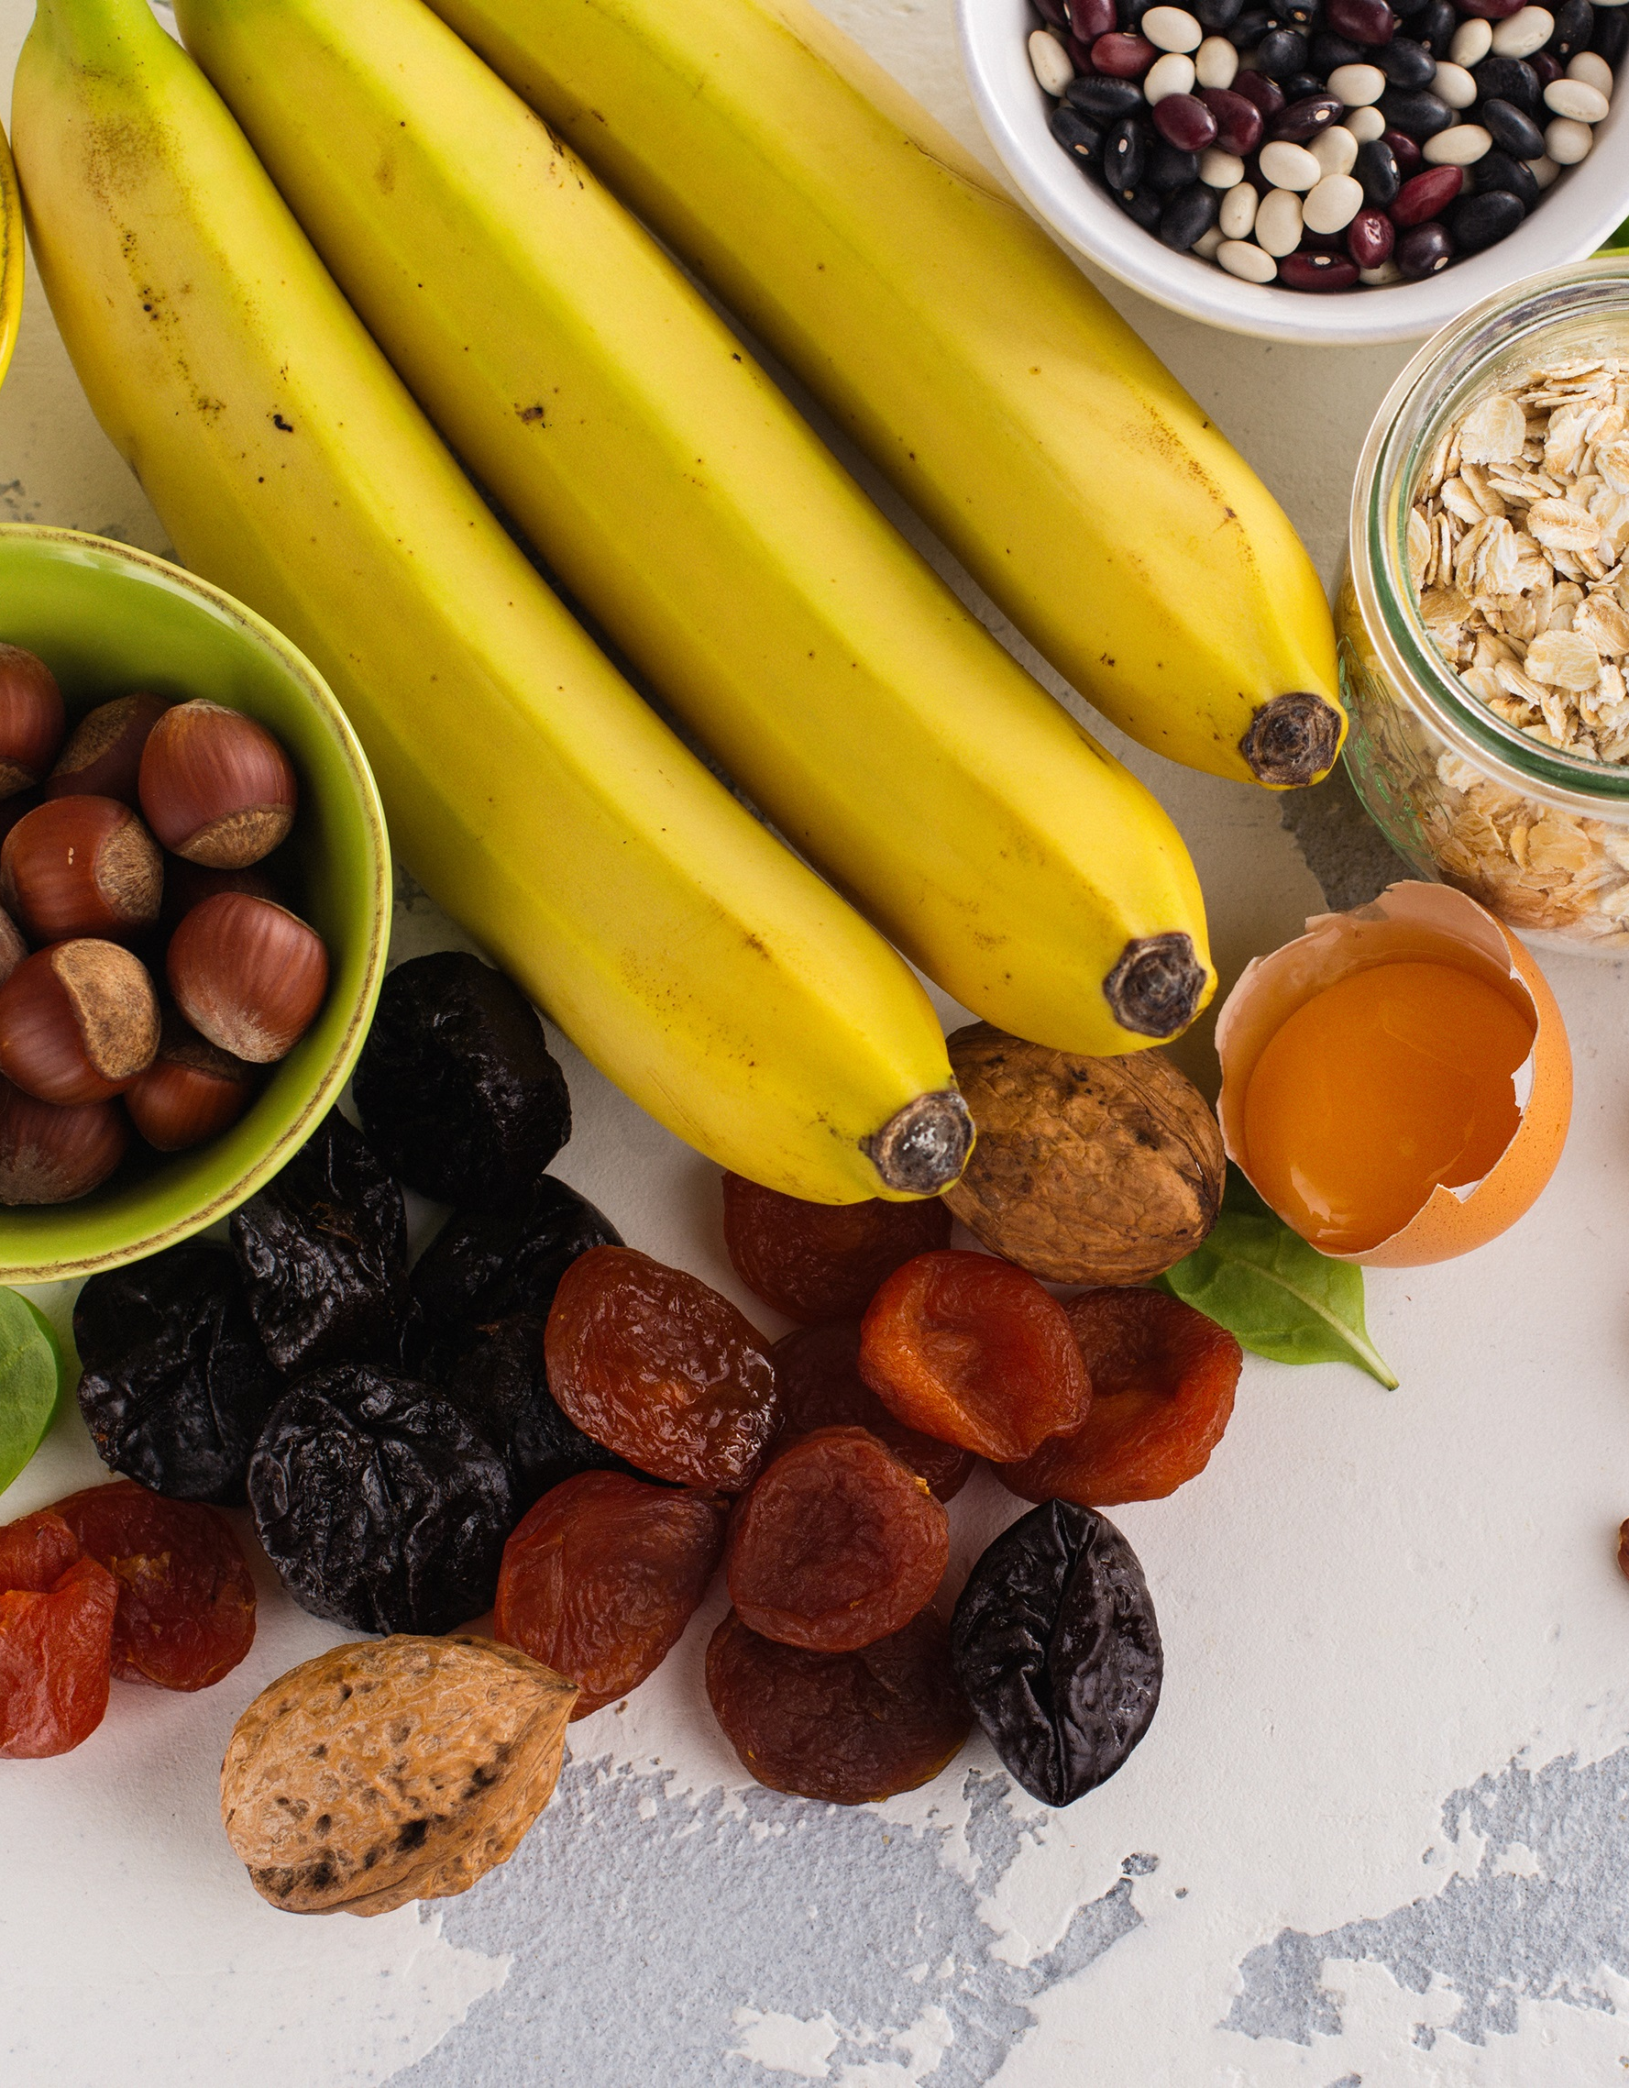
Daily recommended
potassium consumption –
3,500-4,700 mg/day†
Excellent sources of potassium include:
beans, lentils, potatoes, sweet potatoes, spinach, avocado, yogurt, dried apricots, and prunes.
Good sources of potassium include: bananas, tomatoes, oranges, nuts, and leafy greens.
† Based on WHO (2012, reaffirmed 2023) and U.S. FDA (21 CFR § 101.9) guidelines for adults
Notes:
98% of potassium is found inside cells, and only 2% is in the extracellular space, but even that is a lot.
Potassium — an essential electrolyte, necessary for conducting nerve impulses.
The recommended daily intake for adults is 2500 mg, and for athletes — 4700 mg.
It is the strongest natural diuretic.
Under natural conditions, potassium compounds should enter the body with food. It is found in dairy products, meat, cocoa, tomatoes, legumes, bananas, potatoes, parsley, plums, apricots, raisins, prunes.
References on Potassium levels: †World Health Organization (2012, reaffirmed 2023) — Guideline: Potassium Intake for Adults and Children [ https://www.who.int/news/item/31-01-2013-who-issues-new-guidance-on-dietary-salt-and-potassium] ; †U.S. FDA (current 2025) — 21 CFR § 101.9 – Nutrition labeling of food (Daily Value for Potassium)[https://www.ecfr.gov/current/title-21/chapter-I/subchapter-B/part-101/subpart-A/section-101.9 ]

Slide 13

Unfortunately, most of us do not consume enough potassium in our diets.
Notes:
:Unfortunately, the actual nutrient content in vegetables and fruits has decreased by 30-50% over the last 50 years.
Reasons: soil depletion, widespread deterioration of the ecological situation, use of chemical fertilizers, GMOs, etc.

Slide 14

If you play sports, exercise, or have a physically demanding job,
you need more potassium.
Notes:
Other factors that disrupt the water-salt balance are: regular stress, intense physical activity, bad habits (alcohol, smoking), poor environmental conditions, taking diuretics or laxatives, body dehydration due to vomiting or diarrhea, increased sweating, frequent consumption of chocolate and coffee.

Slide 15



PENTOKAN
AN ACTIVE FORMULA
(POTASSIUM + VITAMIN С + RIBOSE)*
BIOAVAILABLE FORM*
SUPPORTS HEALTHY INTRACELLULAR METABOLISM*
*These statements have not been evaluated by the Food and Drug Administration. This product is not intended to diagnose, treat, cure, or prevent any disease.*
Notes:
Introducing PentoKan — a product specially created to prevent potassium deficiency precisely in the cell — the initial structural building block of the body.
The task of PentoKan is to ensure a constant concentration of potassium inside the cell.
This is the key to the healthy functioning of the cell and the body as a whole.

Slide 16

Product Formula
C
K+
RIBOSE
Notes:
Pentokan’s active components are potassium, vitamin C, and Ribose.

Slide 17
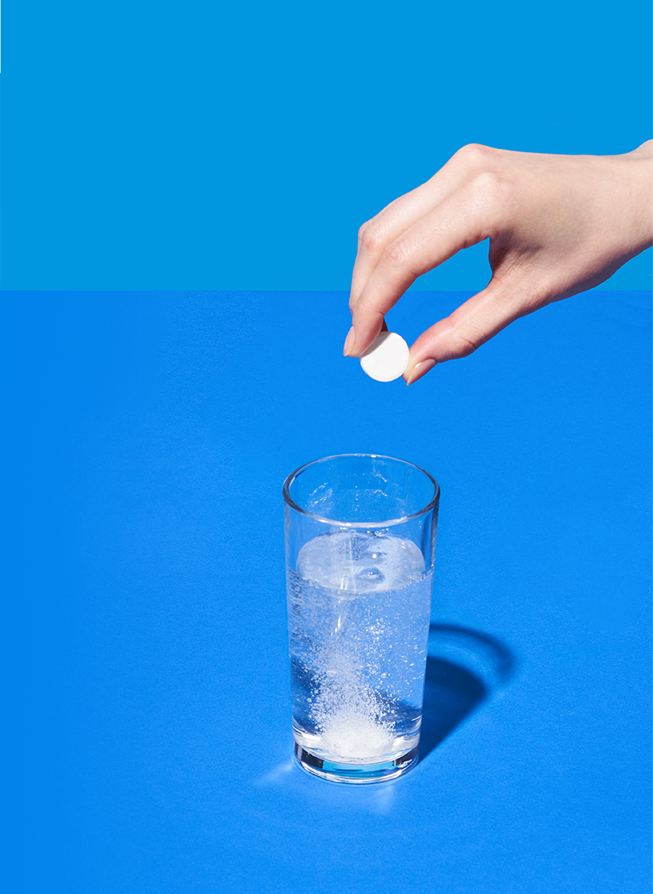
POTASSIUM
PENTOKAN – A SOURCE OF POTASSIUM
Potassium is essential for maintaining normal cellular metabolism*
Fast-absorbing effervescent form*
Provides higher potassium bioavailability*
*These statements have not been evaluated by the Food and Drug Administration. This product is not intended to diagnose, treat, cure, or prevent any disease.
Notes:
First of all, PentoKan is a source of potassium.
Our task was to present this macroelement in the most bioavailable form.
When dissolved in water, effervescent tablets form two organic forms of potassium — citrate and ascorbate.
Thus, a bioavailability of about 97.5% is achieved.

Slide 18
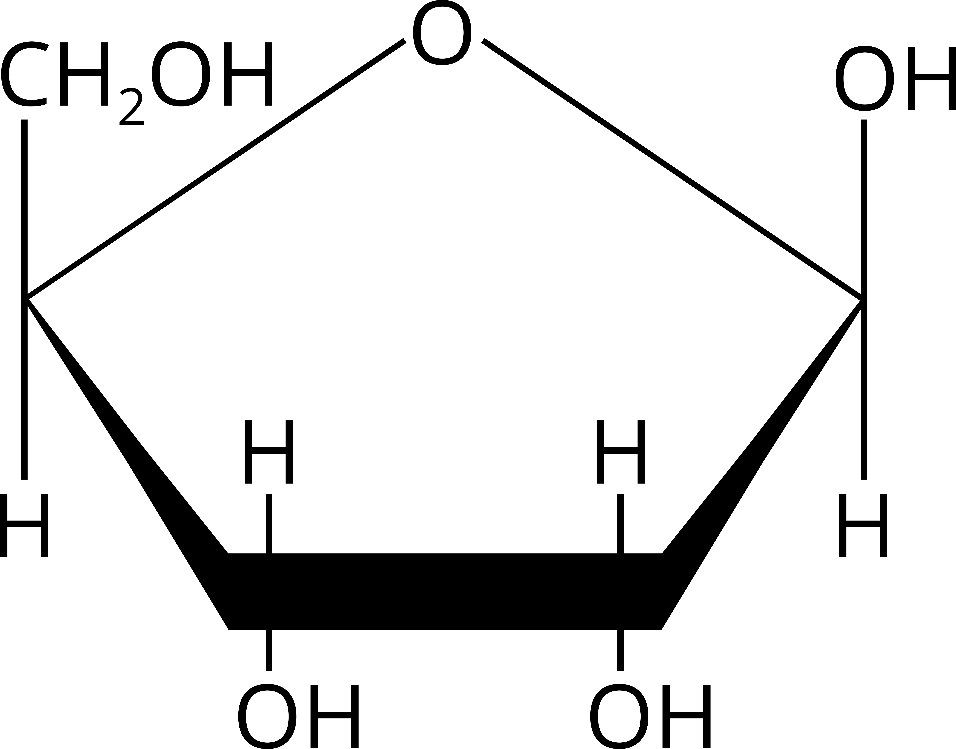
Ribose –
monosaccharide from the pentose group (a natural carbohydrate)
Ribose is a key structural component of ATP, supporting the body’s natural energy processes.*
Ribose helps cellular energy recovery after physical exertion and contributes to normal metabolic function.*
*These statements have not been evaluated by the Food and Drug Administration. This product is not intended to diagnose, treat, cure, or prevent any disease.
Notes:
Ribose is the second active component of PentoKan – it increases ATP synthesis.
ATP (adenosine triphosphate) is the main source of energy, a universal energy carrier necessary for maintaining the normal functioning of any living cell.
For this reason, potassium content and a normal ATP level are closely related. Potassium ions freely and quickly enter the cell, increasing its ATP reserves. At a high ATP level, it ensures the optimal content of other important cations and anions, which ensures proper cell functioning.

Slide 19


Vitamin С
Plays an important role in the formula, working synergistically with potassium, to support efficient cellular uptake and utilization for normal energy metabolism.*
K
С
*These statements have not been evaluated by the Food and Drug Administration. This product is not intended to diagnose, treat, cure, or prevent any disease.
Notes:
Vitamin C, in turn, plays an important transport role in the PentoKan formula, and due to its synergistic structure, it contributes to the rapid and efficient delivery of potassium into the cell.

Slide 20
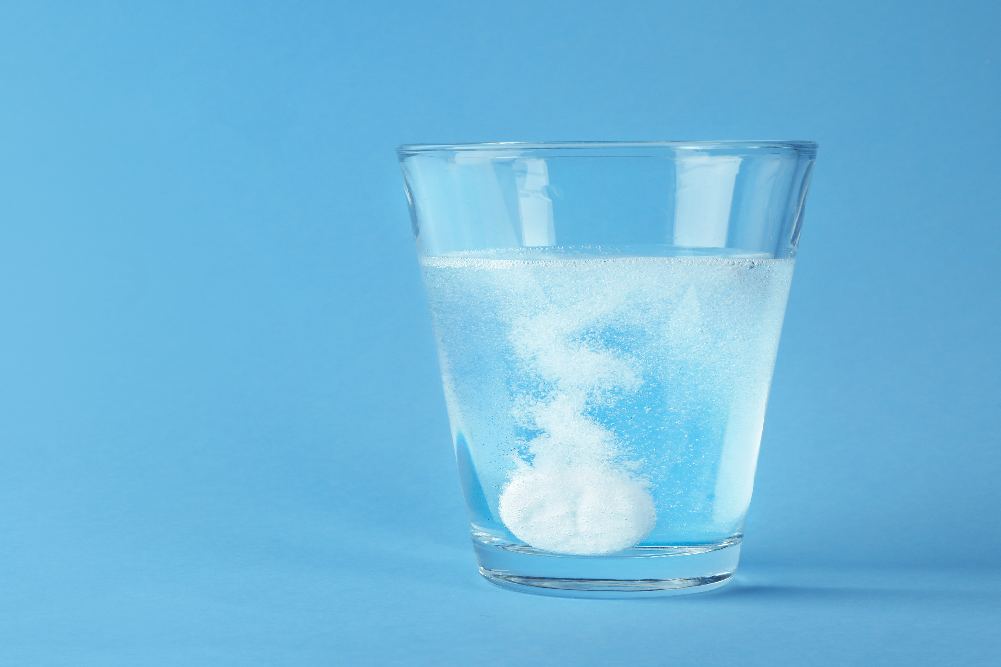
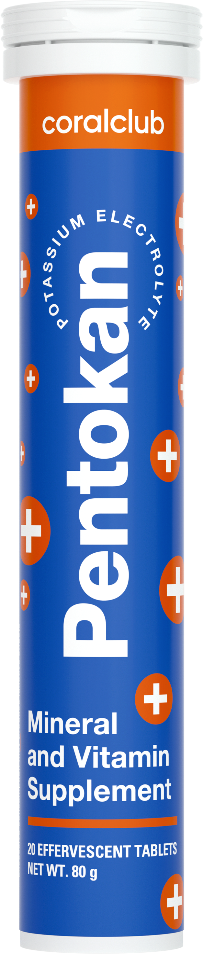
Ready in just 1 minute!
Simply dissolve 1 effervescent tablet in 150 ml of water or fruit juice.
Take 1 tablet 1-2 times a day before or during meals.
Notes:
Simply dissolve an effervescent tablet in a glass of water or juice.
It's more convenient and pleasant than swallowing capsules!

Slide 21
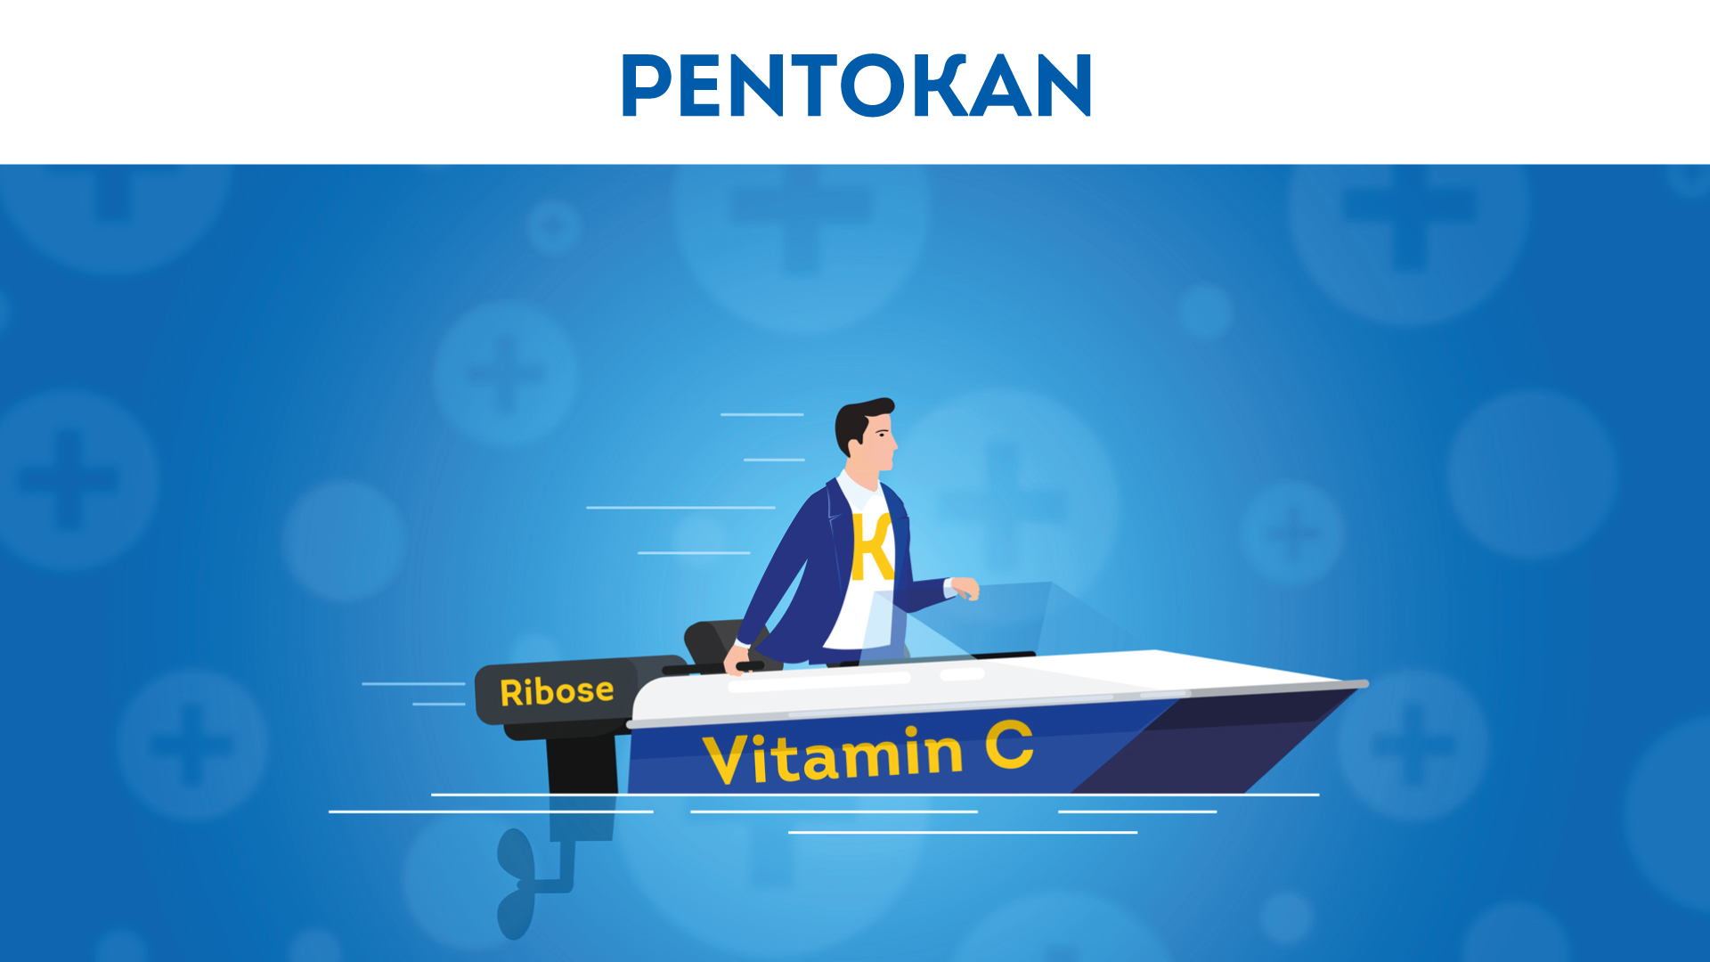


CORAL-CLUB.COM
Notes:
PentoKan is an optimal combination of active ingredients for rapid restoration of the energy potential of cells. It ensures the optimal functioning of the sodium-potassium pump and promotes the removal of unnecessary sodium from the cell in conditions of oxidative stress.

Slide 22
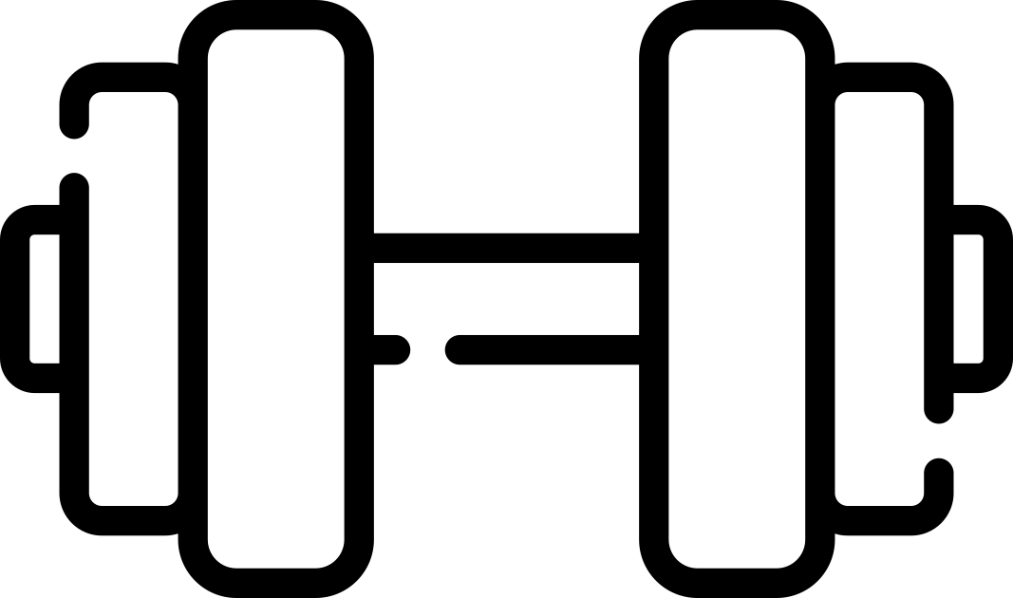



Recommended for:
Everyone who actively engages in physical exercise.
Those who regularly consume coffee, chocolate, or alcohol.
People who frequently experience nervous tension or stress.
People with inadequate nutrition, or who frequently consume salty foods.
Those who want to support heart and muscle health and maintain normal electrolyte balance.*
*These statements have not been evaluated by the Food and Drug Administration. This product is not intended to diagnose, treat, cure, or prevent any disease.*

Slide 23
Pentokan
Potassium Electrolyte
2182
7.5
BONUS POINTS
15.00 USD
CLUB PRICE
RETAIL PRICE
18.75 USD

Slide 24
PENTOKAN
Power for Cellular Health*
*These statements have not been evaluated by the Food and Drug Administration. This product is not intended to diagnose, treat, cure, or prevent any disease.

