Slide 1


Your inner pillar of support
Calci-Prime

Slide 2






Each of us has our own lifestyle,
special interests, needs and habits...
Some people are always on the move,
relying on coffee and regular exercise
to keep them going.
Some have gained life experience and see their
bodies change, yet they strive to remain active
and full of energy.
Some are teens eager to hang out
with friends daily, indulging in salty
fries and fizzy drinks.
Some prefer staying indoors, rarely venturing
into sunlight or taking vitamin D supplements.
Some opt for a vegetarian or vegan lifestyle, forgoing dairy products altogether.
Calci-Prime

Slide 3


We are all different,
and we don't always see what we have in common.
[Ca]
Calcium
~ 3.5 billion people are at risk of calcium deficiency[1]
Calci-Prime
read the study

Slide 4






Calcium is the most abundant mineral in the body,
most of which is stored in bones (98-99%)
Calcium deficiency can lead to
brittle bones and higher risk of fractures [2]
arrhythmia and impaired memory [5, 6]
tooth decay and gum disease [3]
weakness and rapid fatigue [7]
cramps and tingling in the hands and feet [4]
worsening of PMS symptoms in women [8]
Calci-Prime

Slide 5
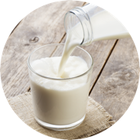
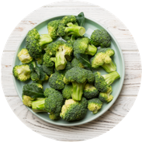
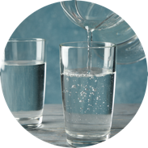
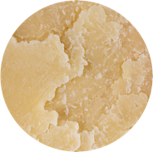
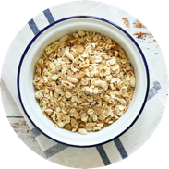
Inevitable losses: the body expels about
1,000 mg of calcium daily.
Calcium plays a crucial role in all life processes, making maintaining regular intake essential.
~ 830 ml (3.5 cups) of milk
~ 900 g boiled broccoli (2 lbs)
~ 2.8 l (12 cups)
mineral water
Estimated quantities of foods containing
a daily calcium allowance of 1,000 mg.
~ 90 g parmesan cheese (3 oz)
~ 2 kg granola
(4.4 lbs)
Calci-Prime
read the study

Slide 6






Only 30% of calcium is absorbed from food.
You might need more if:
Your diet is high in table salt,
alcohol, or caffeine (≥400 mg/day).
You're a woman going through menopause.
You have a vitamin D3 deficiency.
You're a child or teenager
experiencing rapid growth.
You engage in intense physical activity.
You're experiencing long-term stress.
Calci-Prime

Slide 7

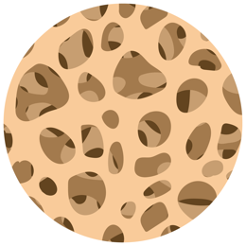


What happens when calcium intake is low?
The body taps into calcium reserves from bones and teeth. Since bone tissue constantly renews, long-term calcium withdrawal leads to reduced bone mineral density and an increased risk of fractures.
Healthy bones and teeth
calcium leaching
Development of osteoporosis
Calci-Prime

Slide 8

*Calcium deficiency impacts more than just bones and teeth; it's vital for proper blood clotting, heart function, muscle function, and nervous system operation.
Since we recognize the importance of Calcium, we developed Calci-Prime, a modern product that incorporates the latest calcium absorption research.
Calci-Prime

Slide 9
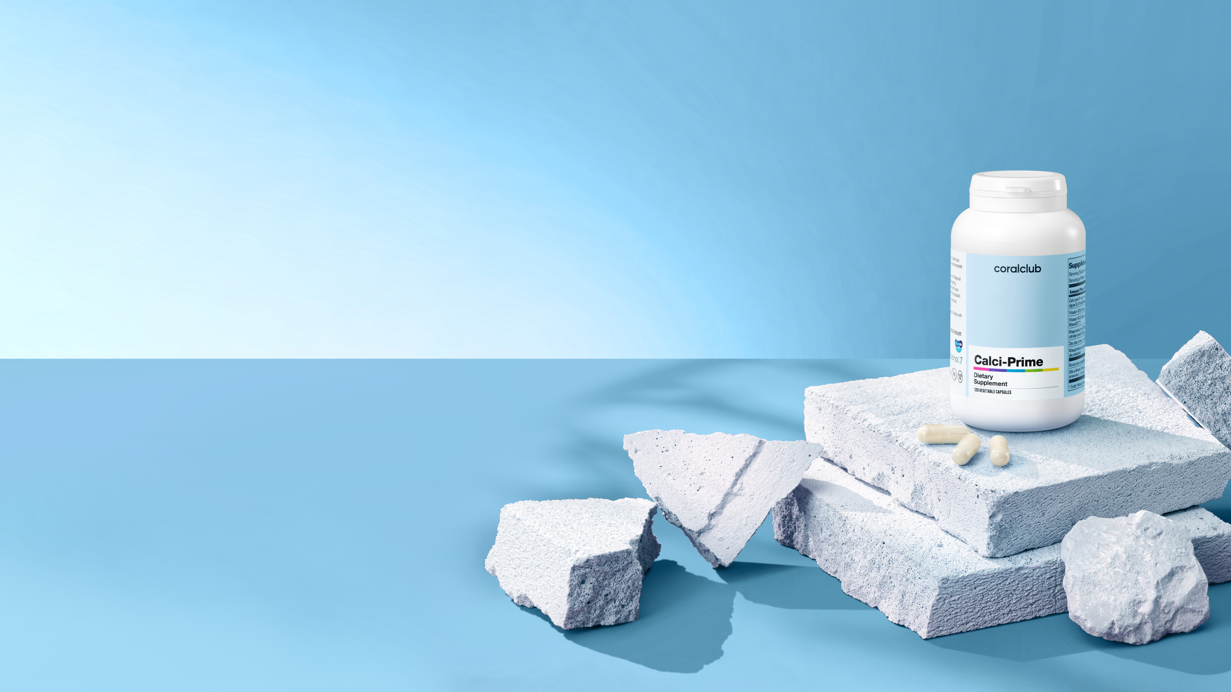
A well-balanced calcium source
-Inspired by nature: enhanced with 5 minerals and 2 vitamins
An all-in-one product to
help with calcium deficiency
Calci-Prime

Slide 10
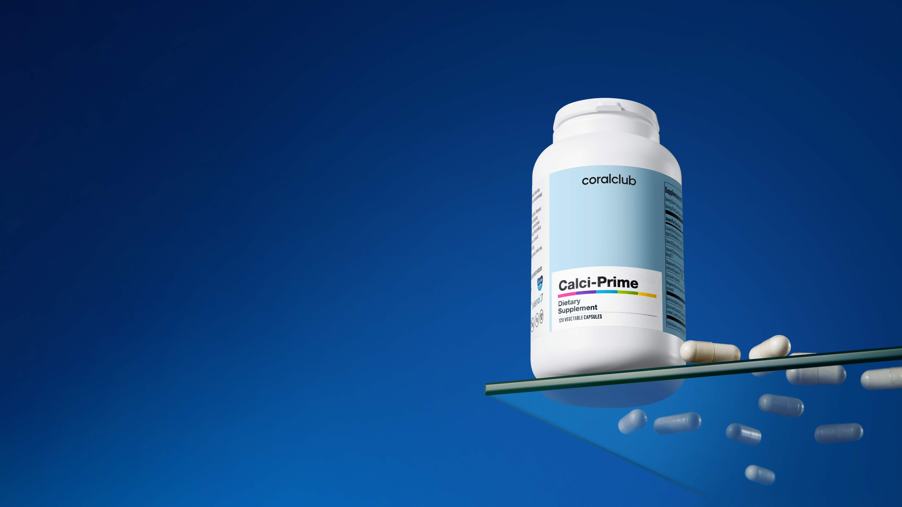
Calci-Prime
What's inside?
Calci-Prime

Slide 11
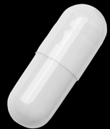
Calci-Prime
Daily dose active ingredient content (4 capsules):
calcium from Aquamin^{ТМ} — 550 mg
magnesium from Aquamin^{ТМ} and magnesium citrate - 160 mg
zinc — 5.36 mg
manganese — 1 mg
silicon — 8 mg
boron — 0.8 mg
vitamin D3— 5 mcg
vitamin К2 — 75.2 mcg
Calci-Prime

Slide 12

Natural calcium from AquaminTM,
a polymineral complex
A unique, bioavailable mineral source derived from red marine algae (lithothamnium) for bone, joint, and digestive health.
Calci-Prime
*Contains ~30% calcium, magnesium and trace amounts of other sea minerals

Slide 13

In Pursuit of the Best: Calcium from
the northen Atlantic Ocean Depths
Lithothamnium grows in the cold eco-friendly waters near Ireland and Iceland.
The algae accumulate calcium, magnesium, and other minerals, becoming as strong as stone.
Ocean ecology is unharmed: as calcined lithothamnium plates are carefully collected and turned into Aquamin™ powder.
Calci-Prime
watch video

Slide 14



25 studies, including two randomized,
double-blind clinical trials, reveal promising results:
Supports bone mineral density.
Reduces knee joint osteoarthritis pain.
Lowers cholesterol levels in postmenopausal women.
Calci-Prime

Slide 15
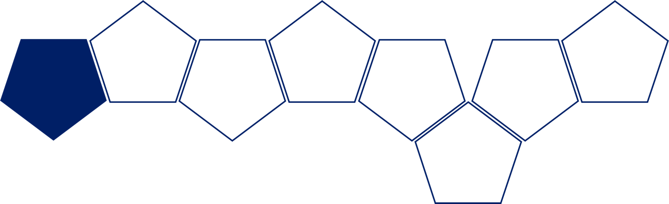
Calcium isn't easily absorbed by itself.
It requires certain vitamins and minerals to increase
its bioavailability and to strengthen bone tissue.
D3
K2
B
Ca
Vitamin
Mg
Vitamin
Si
Zn
Boron
Calcium
Magnesium
Silicon
Zinc
Mn
~ 60% of magnesium is found in bone tissue ^{[20]}
~30% of zinc is found in bone tissue ^{[21]}
Manganese
Calci-Prime

Slide 16




Calci-Prime contains "sunny" vitamin D3:
Helps enhance intestinal calcium absorption.
Promotes calcium accumulation in bones.
To improve its absorption, calcium should be taken together with vitamin D3
Supports healthy bones, teeth, and muscles.
Calci-Prime

Slide 17



In Calci-Prime: Vitamin K2 is in its most
bioavailable form, MenaQ7™:
Promotes timely bone renewal.
Participates in
blood clotting processes.
Patented ingredient
20 clinical trials confirm ingredient safety and effectiveness.
Calci-Prime
read the study

Slide 18
The Calci-Prime formula is enhanced with:
[Mg]
magnesium
[B]
boron
Supports proper muscle function,
crucial for the "contraction-relaxation"
process.
Promotes vitamin D3 conversion into its active form.
  Both assist bone tissue calcium absorption and increased hardness.
Calci-Prime
read the study

Slide 19
The Calci-Prime formula is fortified with:
[Mn]
manganese
[Si]
silicon
[Zn]
zinc
Necessary for proper new cartilage
tissue formation and
synovial fluid synthesis.
An essential structural component
of bones and joints (collagen,
glycosaminoglycans).
Plays a role in mineral metabolism
and collagen synthesis.
Minerals contribute to bone and joint health by affecting bone elasticity.
Calci-Prime
read the study

Slide 20

Take 2 Calci-Prime capsules twice a day with a meal, and experience life in motion.
Calci-Prime

Slide 21
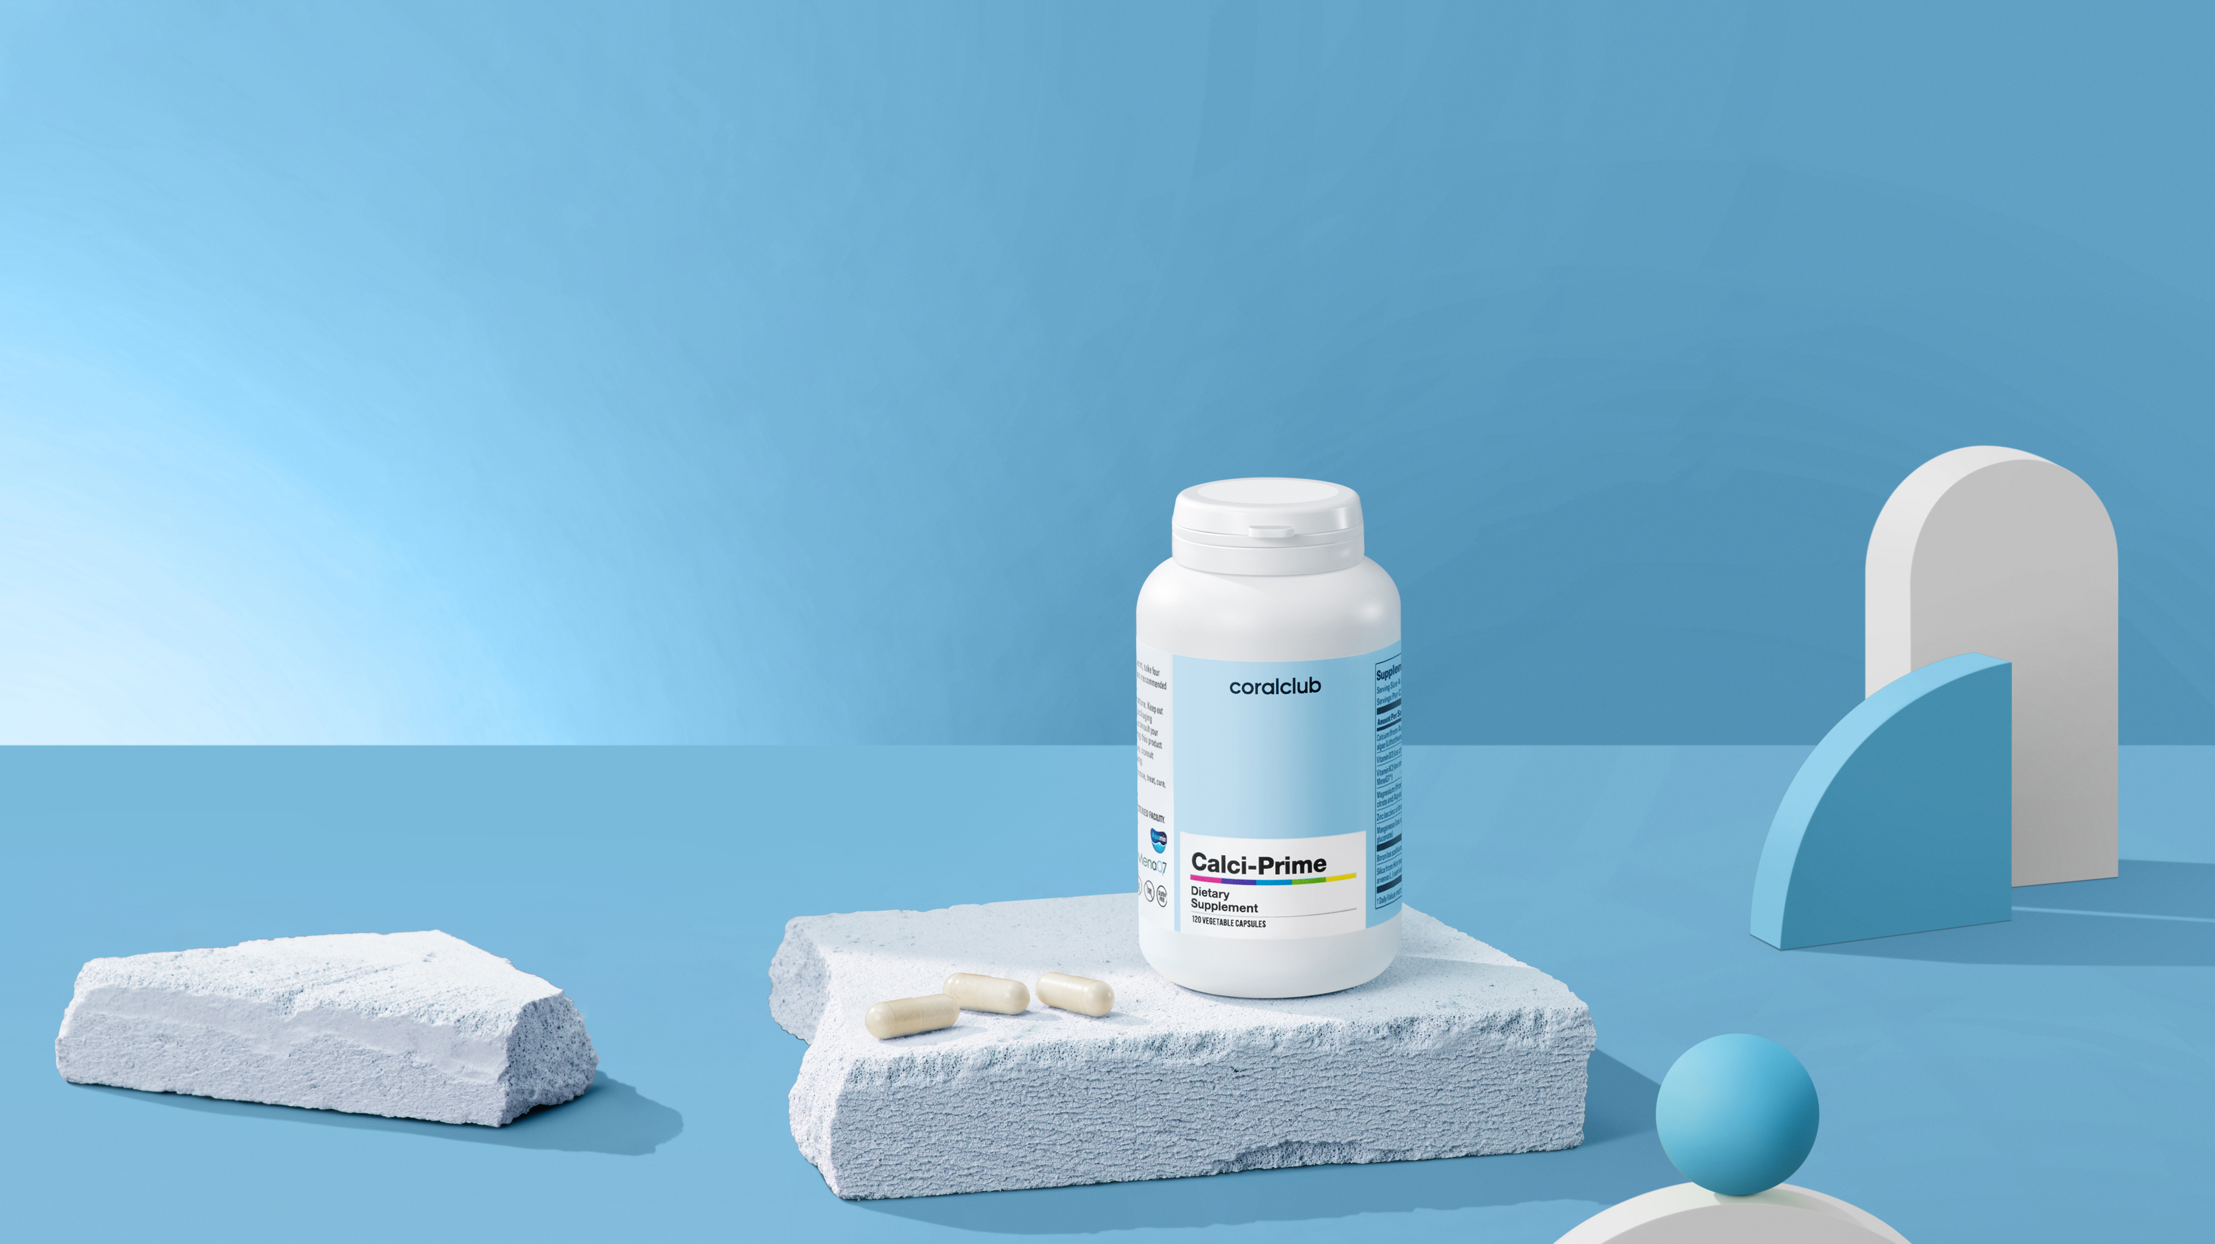




Calci-Prime will help:
Strengthen bones and teeth by providing
nutrients to enhance their mineral density
Maintain healthy joints and muscle function
Support vascular elasticity
Calci-Prime

Slide 22
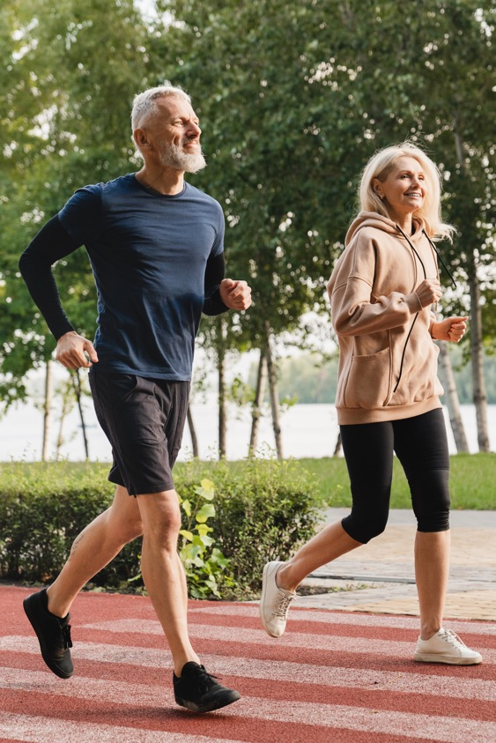
Calci-Prime is perfect for those
with an increased need for
calcium:
Athletes with high physical demands
Elderly individuals and menopausal women
Vegetarians and vegans
Smokers and those consuming many carbonated,
energy drinks, and salts
Underweight and lactose intolerant people
Individuals experiencing chronic stress
This statement has not been evaluated by the Food and Drug Administration. This product is not intended to diagnose, treat, cure or prevent any disease.
Calci-Prime

Slide 23



Calci-Prime features:
Naturally sourced calcium, Aquamin™,
with proven effectiveness
Synergistic Vitamins and Minerals
for enhanced calcium absorption
Calci-Prime

Slide 24
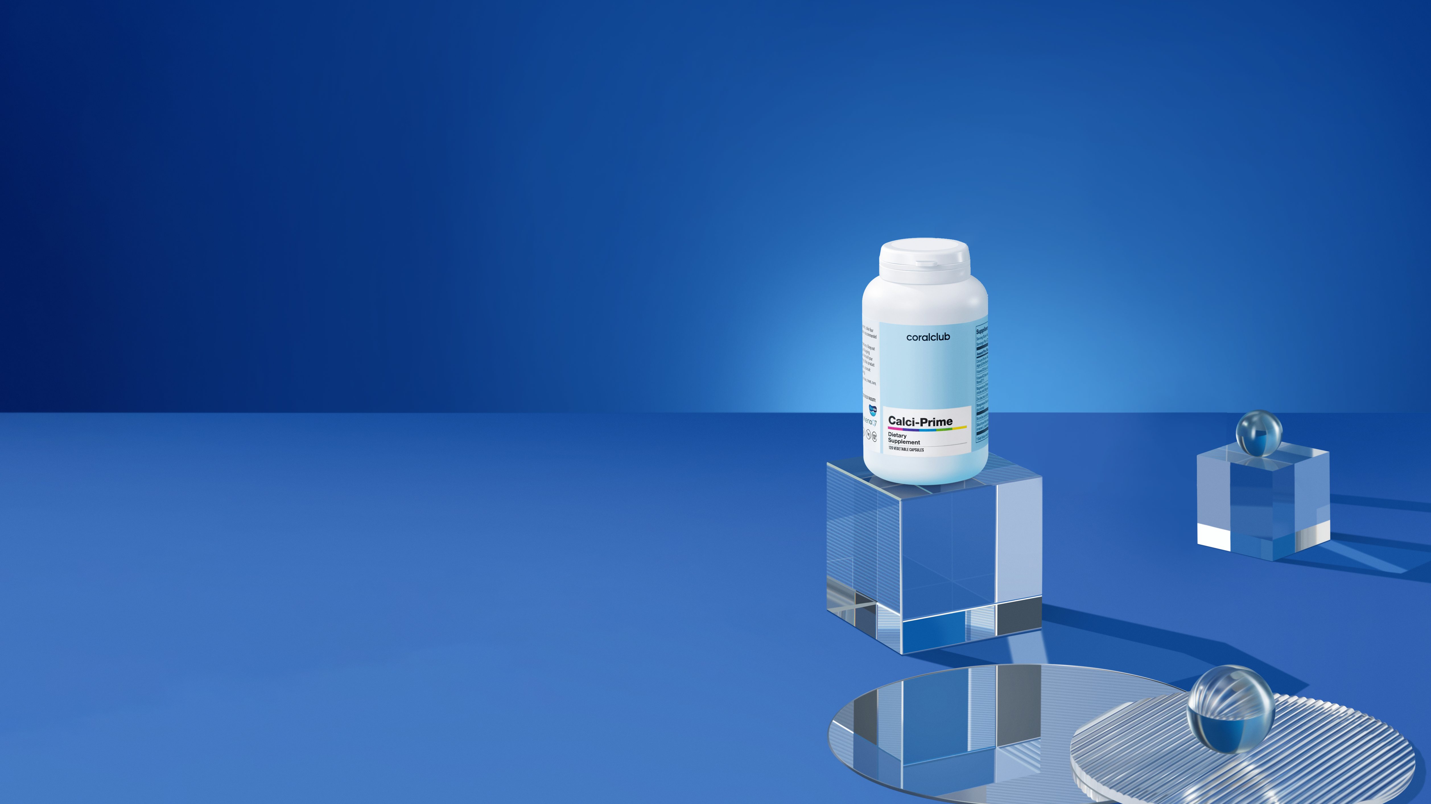
Calci-Prime
2191
BONUS POINTS
CLUB PRICE
RETAIL PRICE
19,0
30.00 USD
37.50 USD
Calci-Prime

Slide 25
Comparing Calci-Prime to
MagiCal and Ca-Mg Complex: what has changed?
Active ingredient Per daily dose (4 capsules/tablets) | Calci-Prime 4 capsules | MagiCal 4 pills | Ca-Mg Complex 4 capsules
Calcium | 550 mg of Aquamin ^{ТМ} | 1090 mg from purified natural marine sediments | 300 mg (malate and citrate)
Magnesium | 160 mg of Aquamin ^{ТМ} and magnesium citrate | 665 mg from natural marine sediments | 100 mg (malate and citrate)
Zinc | 5.36 mg | - | -
Manganese | 1 mg | 150 µg from naturalmarine sediments | -
Silicon | 8 mg |  | 5 mg
Boron | 0.8 mg | - | 1 mg
Vitamin D3 | 5 mcg (200 МЕ) | - | 7.5 mcg (300 МЕ)
Vitamin K2 | 75.2 mcg | - | 150 mcg
Iron | - | 1.5 mg from naturalmarine sediments | -
Chrome | - | 12 µg from naturalmarine sediments | -
Calci-Prime

Slide 26
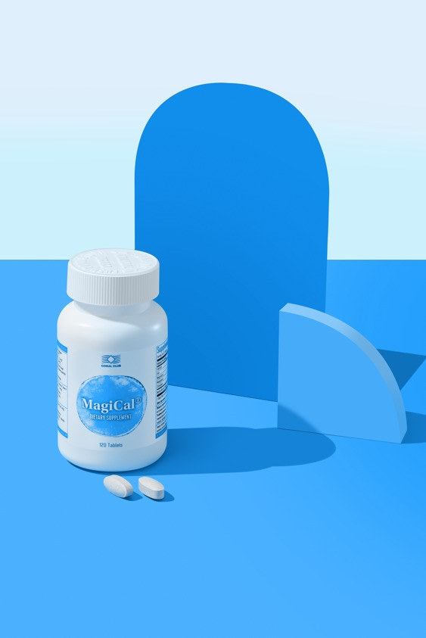



Calci-Prime: advantages
over MagiCal:
Calcium from patented Aquamin™ ingredient with proven efficacy.
Magnesium from two sources: organic salt Magnesium citrate
and natural proprietary ingredient Aquamin™.
Formula enhanced with vitamins D3 and K2, zinc, silicon, and
boron, improving bone mineral metabolism.
Calci-Prime

Slide 27
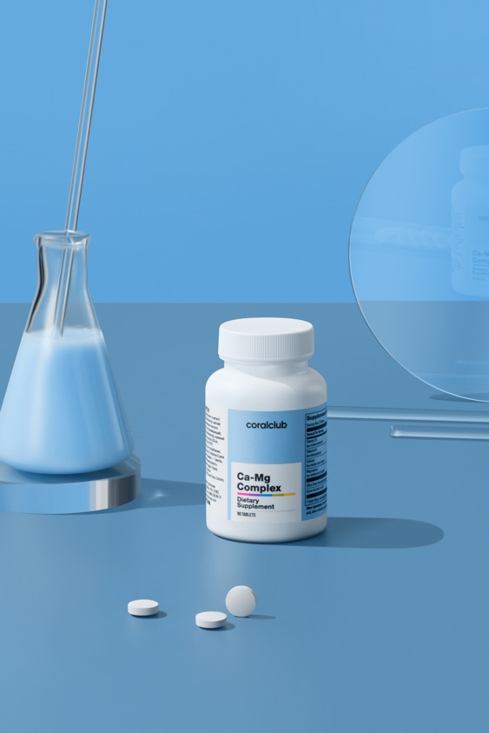



Calci-Prime: advantages over
Ca-Mg Complex:
One daily dose (4 capsules) provides more calcium (+83%) and magnesium (+60%).
Formula fortified with zinc and manganese
One pack lasts for 30 days instead of 22.
This compensates for potential lower bioavailability of calcium from the inorganic carbonate form compared to citrate.
Calci-Prime

Slide 28
Your inner pillar of support
Calci-Prime

Slide 29
Sources and literature
1.
Shlisky J, Mandlik R, Askari S, et al. Calcium deficiency worldwide: prevalence of inadequate intakes and associated health outcomes. Ann N Y Acad Sci.
2022;1512(1):10-28. https://doi.org/10.1111/nyas.14758
2.
Abou Neel EA, Aljabo A, Strange A, et al. Demineralization-remineralization dynamics in teeth and bone. Int J Nanomedicine. 2016;11:4743-4763. Published
2016 Sep 19. https://doi.org/10.2147/IJN.S107624
3.
Wang CJ, McCauley LK. Osteoporosis and Periodontitis. Curr Osteoporos Rep. 2016;14(6):284-291. https://doi.org/10.1007/s11914-016-0330-3
4.
Südhof TC. Calcium control of neurotransmitter release. Cold Spring Harb Perspect Biol. 2012;4(1):a011353. Published 2012 Jan 1.
https://doi.org/10.1101/cshperspect.a011353
5.
Johnson JD, Jennings R. Hypocalcemia and Cardiac Arrhythmias. Am J Dis Child. 1968;115(3):373–376. https://doi.org/10.1001/archpedi.1968.02100010375014
6.
Juan D. Hypocalcemia. Differential diagnosis and mechanisms. Arch Intern Med. 1979;139(10):1166-1171. https://doi.org/10.1001/archinte.139.10.1166
7.
Oudesluys-Murphy AM, de Vries AC. Fatigue due to hypocalcaemia. Lancet. 2002;359(9304):443. https://doi.org/10.1016/s0140-6736(02)07574-8
8.
Abdi F, Ozgoli G, Rahnemaie FS. A systematic review of the role of vitamin D and calcium in premenstrual syndrome [published correction appears in Obstet
Gynecol Sci. 2020 Mar;63(2):213]. Obstet Gynecol Sci. 2019;62(2):73-86. https://doi.org/10.5468/ogs.2019.62.2.73
9.
Institute for Quality and Efficiency in Health Care (IQWiG). How can I get enough calcium? Updated October 18, 2018 Accessed March 2, 2023.
https://www.ncbi.nlm.nih.gov/books/NBK279330/
10.
Institute of Medicine (US) Committee to Review Dietary Reference Intakes for Vitamin D and Calcium. Dietary Reference Intakes for Calcium and Vitamin D.
National Academies Press; 2011. https://doi.org/10.17226/13050
11.
Nordin BE, Need AG, Morris HA, Horowitz M. The nature and significance of the relationship between urinary sodium and urinary calcium in women. J Nutr.
1993;123(9):1615-1622. https://doi.org/10.1093/jn/123.9.1615
Calci-Prime

Slide 30
Sources and literature
12.
Haber PS, Kortt NC. Alcohol use disorder and the gut. Addiction. 2021;116(3):658-667. https://doi.org/10.1111/add.15147
13.
Heaney RP, Rafferty K. Carbonated beverages and urinary calcium excretion. Am J Clin Nutr. 2001;74(3):343-347. https://doi.org/10.1093/ajcn/74.3.343
14.
Klesges RC, Ward KD, Shelton ML, et al. Changes in bone mineral content in male athletes. Mechanisms of action and intervention effects
[published correction appears in JAMA 1997 Jan 1;277(1):24]. JAMA. 1996;276(3):226-230. http://doi.org/10.1001/jama.1996.03540030060033
15.
Heaney RP. Advances in therapy for osteoporosis. Clin Med Res. 2003;1(2):93-99. https://doi.org/10.3121/cmr.1.2.93
16.
Azuma K, Adachi Y, Hayashi H, Kubo KY. Chronic Psychological Stress as a Risk Factor of Osteoporosis. J UOEH. 2015;37(4):245-253.
https://doi.org/10.7888/juoeh.37.245
17.
Barry DW, Hansen KC, van Pelt RE, Witten M, Wolfe P, Kohrt WM. Acute calcium ingestion attenuates exercise-induced disruption of calcium homeostasis.
Med Sci Sports Exerc. 2011;43(4):617-623. https://doi.org/10.1249/MSS.0b013e3181f79fa8
18.
Frestedt JL, Kuskowski MA, Zenk JL. A natural seaweed derived mineral supplement (Aquamin F) for knee osteoarthritis: a randomised, placebo controlled
pilot study. Nutr J. 2009;8:7. Published 2009 Feb 2. https://doi.org/10.1186/1475-2891-8-7
19.
Cronin BE, Allsopp PJ, Slevin MM, et al. Effects of supplementation with a calcium-rich marine-derived multi-mineral supplement and short-chain
fructo-oligosaccharides on serum lipids in postmenopausal women. Br J Nutr. 2016;115(4):658-665. https://doi.org/10.1017/S0007114515004948
20.
de Baaij JH, Hoenderop JG, Bindels RJ. Magnesium in man: implications for health and disease. Physiol Rev. 2015;95(1):1-46.
https://doi.org/10.1152/physrev.00012.2014
21.
Uwitonze AM, Ojeh N, Murererehe J, Atfi A, Razzaque MS. Zinc Adequacy Is Essential for the Maintenance of Optimal Oral Health. Nutrients.
2020;12(4):949. Published 2020 Mar 30. https://doi.org/10.3390/nu12040949
22.
Science – MenaQ7. MenaQ7. Accessed March 2, 2023. https://menaq7.com/science/
Calci-Prime

Slide 31
Sources and literature
23.
Rondanelli M, Faliva MA, Peroni G, et al. Pivotal role of boron supplementation on bone health: A narrative review. J Trace Elem Med Biol. 2020;62:126577.
https://doi.org/10.1016/j.jtemb.2020.126577
24.
Rondanelli M, Faliva MA, Peroni G, et al. Silicon: A neglected micronutrient essential for bone health. Exp Biol Med (Maywood). 2021;246(13):1500-1511.
https://doi.org/10.1177/1535370221997072
Calci-Prime

