Slide 1


D-Spray
Your personal ray of sunshine

Slide 2





Vitamin D regulates virtually all processes in the body
The body synthesizes this vitamin when exposed to sunlight.
Up to 50% of UV rays
Vitamin D can be difficult to obtain from food alone.
are blocked by urban dust, smog, and clouds.
D-Spray
These statements have not been evaluated by the Food and Drug Administration. This product is not intended to diagnose, treat, cure, or prevent any disease.
Notes:
The human body is a very complex system in which all elements are constantly interacting with one another. The health and general well-being of a person directly depends on how well-coordinated these interactions are. The effectiveness of vitamins can be enhanced by "helper molecules" or cofactors. These are compounds that are involved in biochemical processes. The most significant cofactors that enhance the efficacy of vitamin D include:
Calcium: Vitamin D controls the level of calcium in the body. The absorption rate of this mineral is improved when a sufficient amount of vitamin D is present. Therefore, these two substances are inextricably linked with each other.
Magnesium: This nutrient has many functions. For example, it is needed by the processes that turn food into energy. Magnesium is also involved in the absorption of calcium, phosphorus, sodium, potassium, and vitamin D. A magnesium deficiency can be replenished not only with the help of dietary supplements but also by including foods such as spinach, nuts, seeds, and whole grains in one's diet.
Vitamin K: This nutrient is responsible for the health of bones and assists with blood clotting. Vitamins D and K work together when it comes to the proper development of the skeletal system. You can replenish vitamin K with foods such as kale, spinach, liver, eggs, and hard cheese.
Zinc: With the participation of zinc, the body grows and develops, cells divide and grow, infections are fought, and carbohydrates are broken down. Zinc also helps vitamin D to work inside cells. A person can get this nutrient from foods such as oysters, cereal, and yogurt.
Boron: The body needs very little of this substance, but it is still indispensable. Boron is involved in the metabolism and absorption of vitamin D. It is found in coffee, peanut butter, wine, avocados, raisins, and some leafy vegetables.
Vitamin A: This nutrient controls protein synthesis. If a person is deficient in vitamin A, then the functionality of vitamin D will be impaired. Vitamin A is a fat-soluble substance and a powerful antioxidant. This nutrient is found in carrots, mangoes, liver, sweet potato, cheese, and milk. (CJR: adding reference for UV rays
References:
PMID: 18637361; Radiation: Ultraviolet (UV) radiation (who.int)
https://ods.od.nih.gov/factsheets/VitaminD-Consumer/

Slide 3
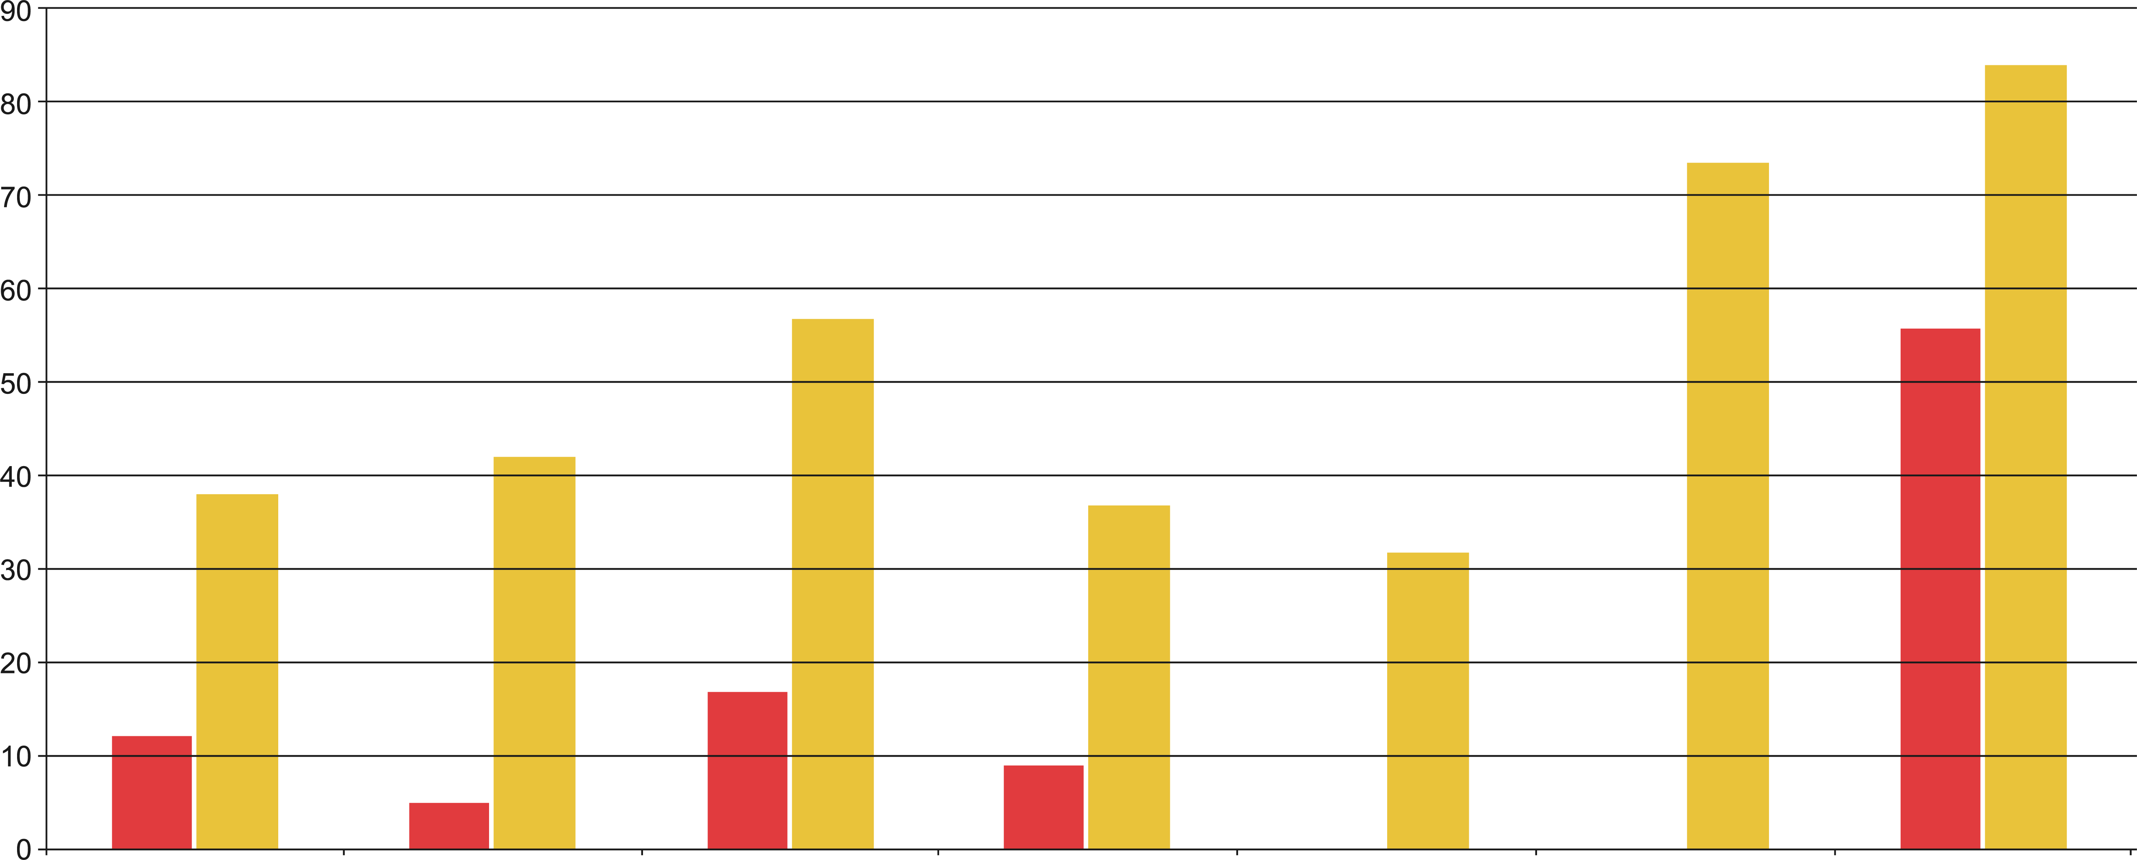
According to latest research, vitamin D deficiencies are found in people all over the world – even in countries with an abundance of sunlight.
Severe deficiency
Low deficiency
Percentage of adults with vitamin D3 deficiency (below 25 nmol/l) or insufficiency (below 50 nmol/l)
Austria
France
Germany
Holland
Spain
Turkey
Russia
D-Spray
Notes:
Austria -
France -
Germany -
Holland
Spain -
Turkey -
Russia -

Slide 4

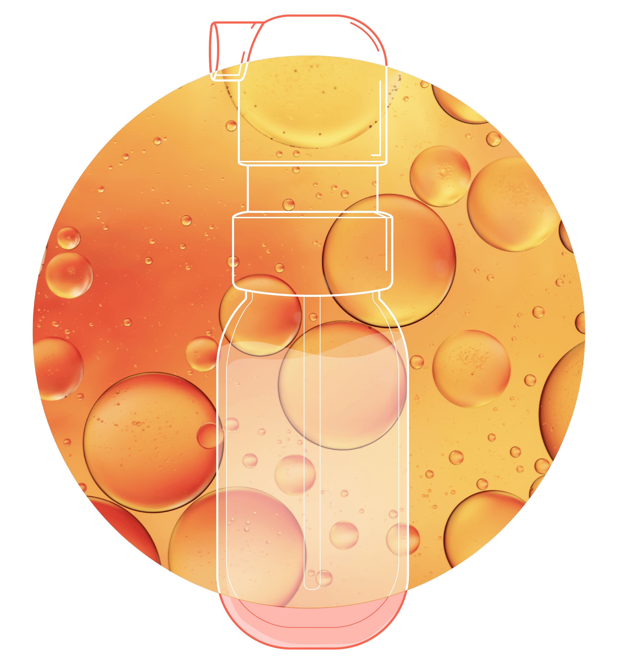
In order for the body’s organs and systems to function properly, Vitamin D has to enter the body in sufficient quantities and also be adequately absorbed.
D-Spray contains MCT fatty acids that promote faster and more natural absorption of Vitamin D.
D-Spray
These statements have not been evaluated by the Food and Drug Administration. This product is not intended to diagnose, treat, cure, or prevent any disease.
Notes:
Since vitamin D itself is fat-soluble, its intake by the body is made more effective when combined with coconut oil. Fat-soluble vitamin D3 tends to accumulate in the liver or adipose tissue, which allows for the creation of a kind of vitamin reserve in the body.
D-Spray, in combination with coconut oil (MCTs - medium-chain triglycerides), is useful for those:
pursuing weight loss;
suffering from indigestion;
suffering from immunodeficiency disorders;
with a high level of physical activity in their daily lives;
who want to help prevent cognitive impairments (associated with memory, attention, etc.).

Slide 5



Sprays are an effective delivery method for vitamin D
The smallest particles of the spray easily penetrate into the bloodstream through the oral mucosa. Fine atomization increases the absorption area.
The fat-soluble spray form of vitamin D is clinically proven*
D-Spray
These statements have not been evaluated by the Food and Drug Administration. This product is not intended to diagnose, treat, cure, or prevent any disease.
Notes:
(*) Claire E. Williams, Elizabeth A. Williams, Bernard M. Corfe. Rate of change of circulating 25-hydroxyvitamin D following sublingual and capsular vitamin D preparations. European Journal of Clinical Nutrition. 23 September 2019.

Slide 6
Microfine mist delivery method provides many benefits:
Easily enters the bloodstream
Increases the area of absorption
Clinically proven to be effective
D-Spray
These statements have not been evaluated by the Food and Drug Administration. This product is not intended to diagnose, treat, cure, or prevent any disease.
Notes:
“Microfine” refers to the extremely small size of the particles released when using D-Spray. Generally speaking, the smaller the particles, the better they will be absorbed by the body.

Slide 7
D-Spray
Your personal ray of sunshine
D-Spray

Slide 8






D-Spray is Vitamin D3 in the form of a spray
Convenient to bring along with you everywhere
No need to drink
1 press of the dispenser equals your daily intake
Precise dosage dispensed
every time
A 10-ml pack contains 170 doses
Dark glass bottle is environmentally friendly, and preserves product freshness
D-Spray
These statements have not been evaluated by the Food and Drug Administration. This product is not intended to diagnose, treat, cure, or prevent any disease.
Notes:
Vitamin D comes in two forms:
Vitamin D3 (cholecalciferol) is synthesized by the skin when exposed to ultraviolet rays. It is also found in certain animal products.
Vitamin D2 (ergocalciferol) is found in some plants, fungi, and yeast. Scientific research suggests that vitamin D3 supplementation is more effective in raising blood levels of vitamin D than vitamin D2*.
*Tripkovic L. et al. Comparison of vitamin D2 and vitamin D3 supplementation in raising serum 25-hydroxyvitamin D status: a systematic review and meta-analysis // Am. J. Clin. Nutr. 2012. Vol. 95, № 6. P. 1357–1364.

Slide 9










D-Spray is the vitamin for the whole family
Suitable for children over 4 years old
Mild, neutral taste of coconut oil will appeal to everyone
Safe for women who are pregnant or breastfeeding
No need to store the product in a dark place away from sunlight
Can be shared by the whole family
Does not require refrigeration
Necessary for your senior loved ones
Helps to boost the immunity of all family members
D-Spray
These statements have not been evaluated by the Food and Drug Administration. This product is not intended to diagnose, treat, cure, or prevent any disease.

Slide 10





Residents of countries in the northern hemisphere
Who is most at risk of vitamin D deficiency?
Those who are not able to properly metabolize vitamin D
Those who are overweight or obese
People who are frequently ill
Experts agree that vitamin D deficiency is becoming an epidemic, affecting children, adolescents, adults, pregnant and lactating
women, and seniors.
Those who have darker skin tones
Elderly people
D-Spray

Slide 11






Common symptoms of vitamin D deficiency often go unnoticed
In adults, these symptoms can include:
Brittle bones, back and joint discomfort
Muscle weakness
Decreased stamina
Frequent respiratory issues
Exacerbation of skin diseases
Sudden mood changes
D-Spray

Slide 12





Regular intake of Vitamin D can help improve:
Sexual Health
Heart Health
Bone Loss
Cognitive Mood
Respiratory Health
D-Spray
Notes:
Munger K.L. et al. Serum 25-Hydroxyvitamin D Levels and Risk of Multiple Sclerosis // JAMA. American Medical Association, 2006. Vol. 296, № 23. P. 2832.
Gillespie K.M. Type 1 diabetes: pathogenesis and prevention // Can. Med. Assoc. J. 2006. Vol. 175, № 2. P. 165–170.
Ginde A.A., Mansbach J.M., Camargo C.A. Association Between Serum 25-Hydroxyvitamin D Level and Upper Respiratory Tract Infection in the Third National Health and Nutrition Examination Survey // Arch. Intern. Med. American Medical Association, 2009. Vol. 169, № 4. P. 384–390.
Urashima M. et al. Randomized trial of vitamin D supplementation to prevent seasonal influenza A in schoolchildren // Am. J. Clin. Nutr. Narnia, 2010. Vol. 91, № 5. P. 1255–1260.
Giovannucci E. et al. 25-Hydroxyvitamin D and Risk of Myocardial Infarction in Men&lt;subtitle&gt;A Prospective Study&lt;/subtitle&gt; // Arch. Intern. Med. American Medical Association, 2008. Vol. 168, № 11. P. 1174.
Pilz S. et al. Association of Vitamin D Deficiency with Heart Failure and Sudden Cardiac Death in a Large Cross-Sectional Study of Patients Referred for Coronary Angiography // J. Clin. Endocrinol. Metab. Narnia, 2008. Vol. 93, № 10. P. 3927–3935.
Pilz S. et al. Low Vitamin D Levels Predict Stroke in Patients Referred to Coronary Angiography // Stroke. Lippincott Williams & Wilkins, 2008. Vol. 39, № 9. P. 2611–2613.
Атейкин А.В., и соавт. Спорные теоретические и практические вопросы рахита у детей на современном этапе // Педиатрия. Журнал им.Г.Н.Сперанского. 2003. Vol. 82, № 4.
Boonen S. et al. Need for Additional Calcium to Reduce the Risk of Hip Fracture with Vitamin D Supplementation: Evidence from a Comparative Metaanalysis of Randomized Controlled Trials // J. Clin. Endocrinol. Metab. Narnia, 2007. Vol. 92, № 4. P. 1415–1423.
Bischoff-Ferrari H.A. et al. Prevention of Nonvertebral Fractures With Oral Vitamin D and Dose Dependency // Arch. Intern. Med. American Medical Association, 2009. Vol. 169, № 6. P. 551.
Bischoff-Ferrari H.A. et al. Fall prevention with supplemental and active forms of vitamin D: a meta-analysis of randomised controlled trials. // BMJ. British Medical Journal Publishing Group, 2009. Vol. 339. P. b3692.
Garland C.F. et al. Vitamin D for Cancer Prevention: Global Perspective // Ann. Epidemiol. Elsevier, 2009. Vol. 19, № 7. P. 468–483.

Slide 13
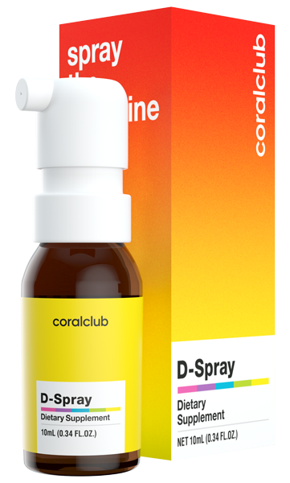
D-Spray
2179
7
BONUS POINTS
12 USD
CLUB PRICE
15 USD
RETAIL PRICE
D-Spray

Slide 14

D-Spray
Your personal ray of sunshine

